Slide 1
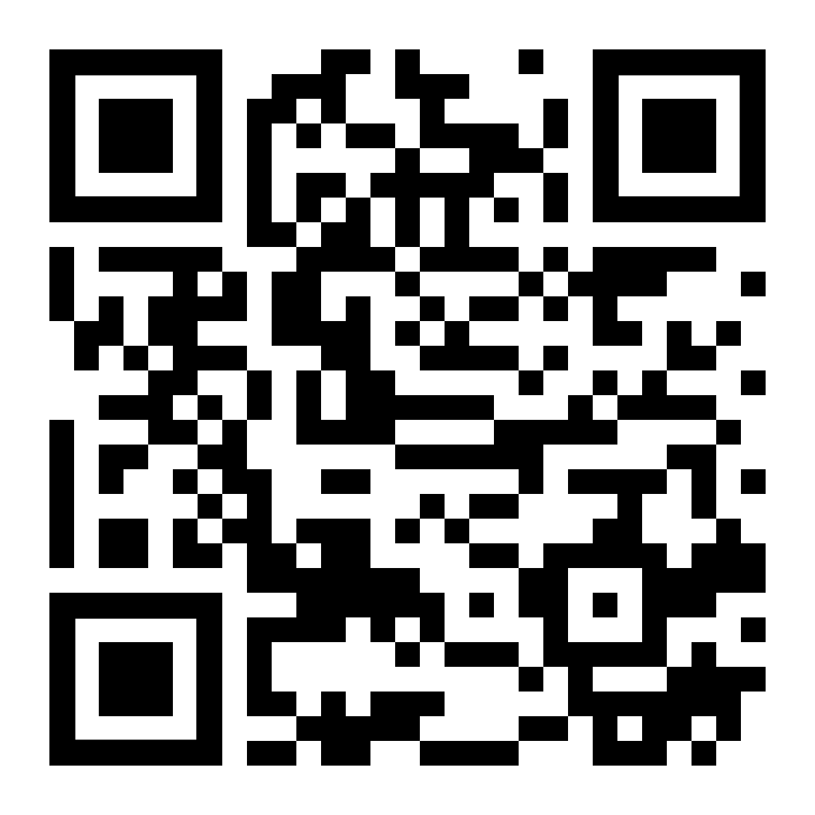
Graph Machine Learning Meets Multi-Table Relational Data
Quan Gan, Minjie Wang
David Wipf, Christos Faloutsos
Accompanying survey paper

Slide 2
Agenda
First half
What is Graph ML?
How to apply Graph ML on multi-tables?
Coffee break (20 min)
Second half
What are the options for each step?
What are the benchmarks?
What are the future directions?

Slide 3
Graph ML Overview

Slide 4



What is Graph ML?
One real-world case:
Detect fraudulent clicks from user interactions.
A user-post interaction network with two types of vertices.
Posts
Users
Notes:
Add another slide

Slide 5
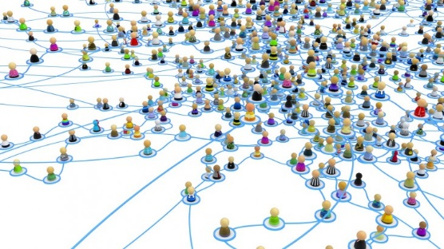
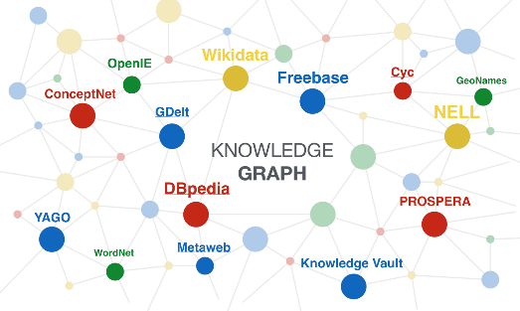
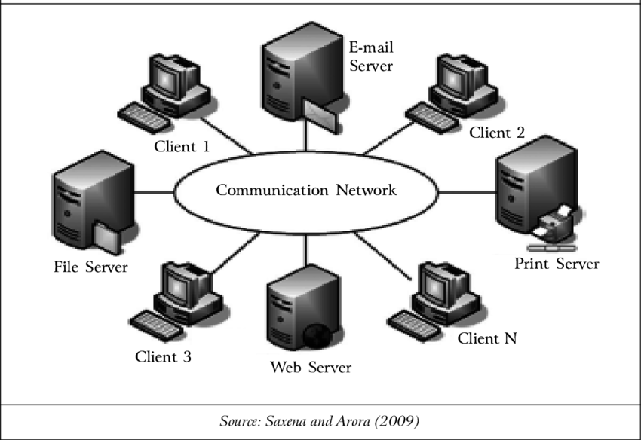
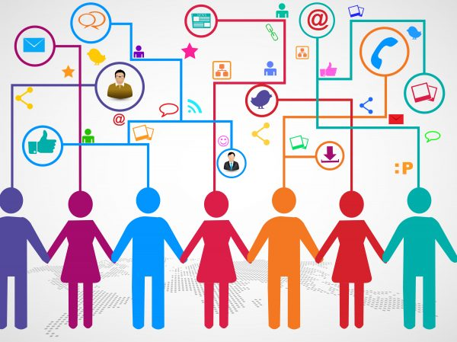
What is Graph ML?
The graphs are often heterogeneous (i.e. nodes and edges have different sets of attributes).
In extreme cases there could be hypergraphs (i.e. an edge can connect to more than two nodes)
Social networks
Knowledge graphs
User behavior
Computer networks

Slide 6
What is Graph ML?
Machine learning models that learn representations of nodes/edges.
Sometimes for graphs as a whole (e.g. molecules), but not our focus today.
GML
Classifier

Slide 7
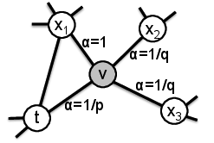
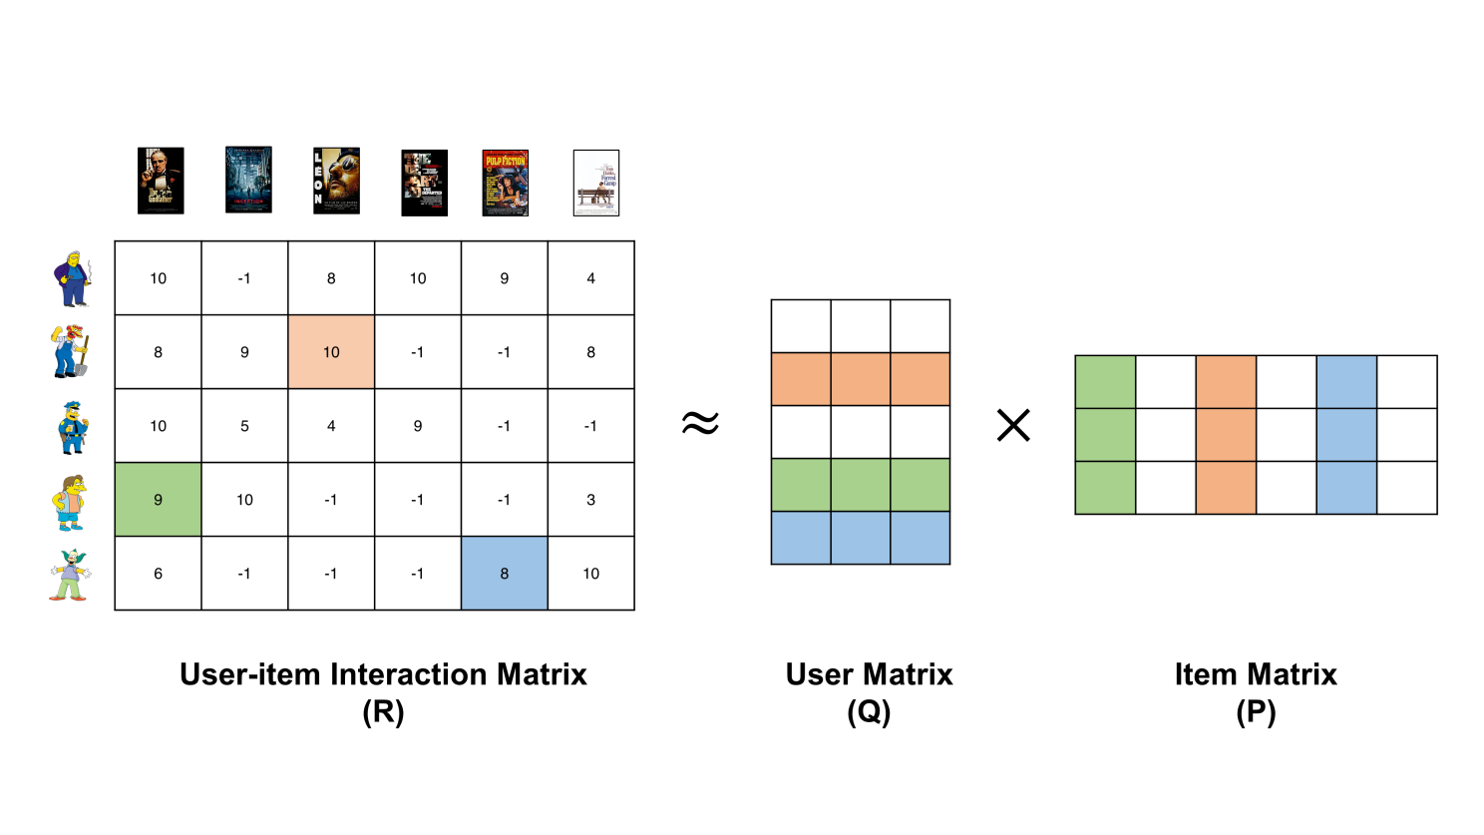
What is Graph ML?
In graph ML, methods could be either:
Transductive (graph topology is known beforehand and unchanged)
Network embeddings, matrix factorization, knowledge graph embeddings…
Node2vec [1]
Matrix factorization
Notes:
Transductive: the model is trained so that it makes prediction on the same exact graph. No new nodes or edges will be added during test time. This allows one to learn an embedding vector for each specific node. For instance, network embedding methods or in a broader sense matrix factorization methods could be considered as transductive graph machine learning approaches. They cannot be easily adapted to new graphs without retraining.

Slide 8
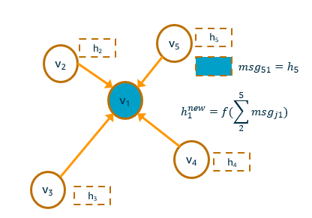
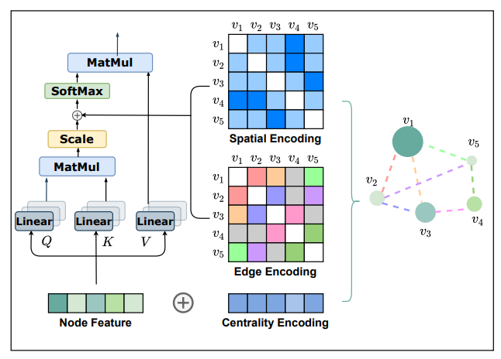
What is Graph ML?
In graph ML, methods could be either:
Transductive (graph topology is known beforehand and unchanged)
Network embeddings, matrix factorization, …
Inductive (does not assume a fixed graph topology)
Message passing neural networks, graph transformers, hypergraph neural networks
Message passing neural networks [1]
[1] Neural Message Passing for Quantum Chemistry, Gilmer et al., 2017
[2] Do Transformers Really Perform Bad for Graph Representation? Ying et al., 2021
Graphormer [2]
Notes:
The math formulation of those methods does not assume a specific topology of the input graph.

Slide 9
What is Graph ML?
In graph ML, methods could be either:
Transductive (graph topology is known beforehand and unchanged)
Network embeddings, matrix factorization, …
Inductive (does not assume a fixed graph topology)
Message passing neural networks, graph transformers, hypergraph neural networks
More options in the second session
Message passing neural networks [1]
[1] Neural Message Passing for Quantum Chemistry, Gilmer et al., 2017
[2] Do Transformers Really Perform Bad for Graph Representation? Ying et al., 2021
Graphormer [2]
Notes:
The math formulation of those methods does not assume a specific topology of the input graph.

Slide 10
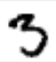
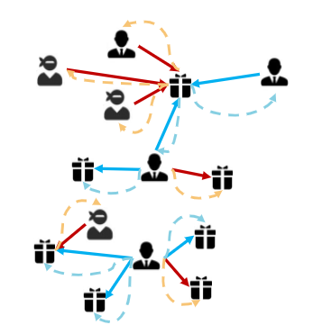
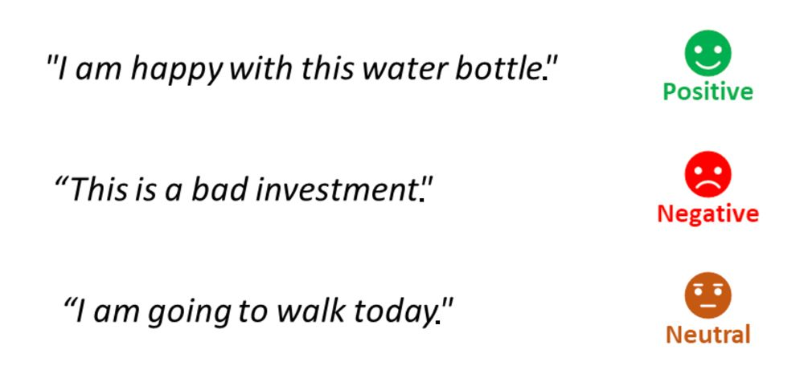


Why traditional ML is not enough?
3
5
8
Typical ML pipelines: all samples are assumed IID
Now: the samples can be interdependent

Slide 11
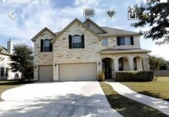
Examples when interdependency matters
Rental scams:
Address | Outdoor images | IsFraud?
XXX, New York City, NY |  | ?
YYY, Boston, MA |  | ?
Photo taken from: Walking away with your money': Family's house target of fraudulent real estate listing, kens5.com

Slide 12
Examples when interdependency matters
One can’t tell if a listing is a scam by looking at the listing alone…
Address | Outdoor images | IsFraud?
XXX, New York City, NY |  | ?
Photo taken from: Walking away with your money': Family's house target of fraudulent real estate listing, kens5.com

Slide 13
Examples when interdependency matters
… but it’s much easier to tell if one looks at other instances
Address | Outdoor images | IsFraud?
XXX, New York City, NY |  | ?
YYY, Boston, MA |  | ?
Same!
Photo taken from: Walking away with your money': Family's house target of fraudulent real estate listing, kens5.com

Slide 14
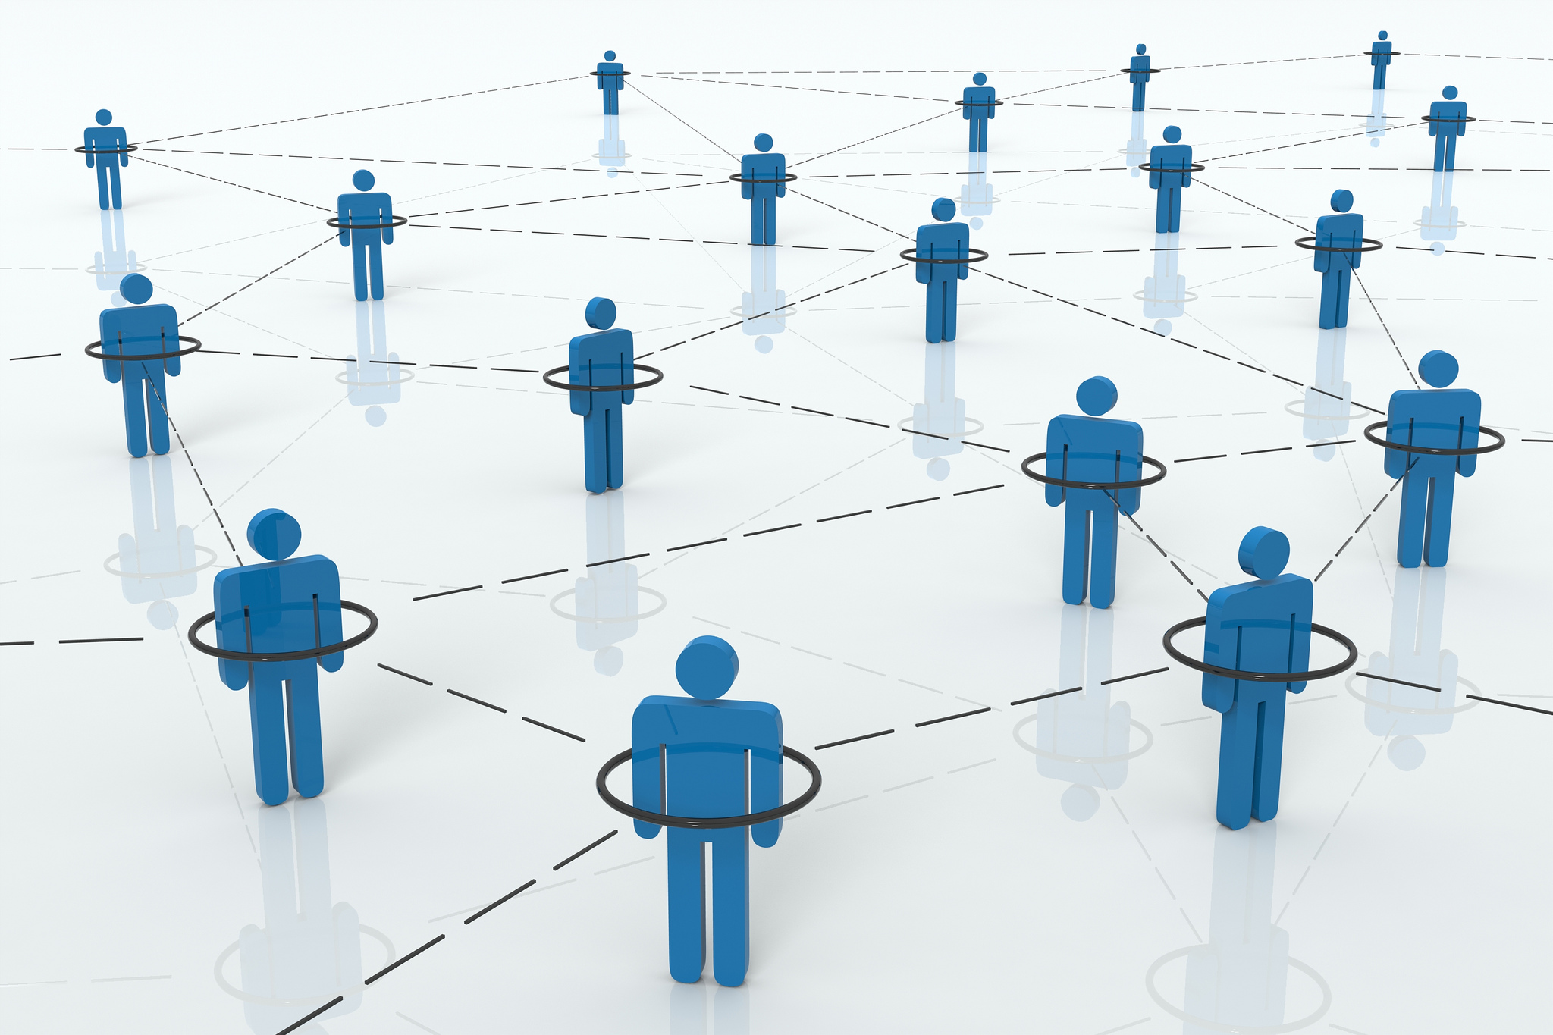
Examples when interdependency matters
Social network event modeling

Slide 15

Examples when interdependency matters
To model user activity, one needs to look at neighboring user’s activities…
Real Madrid No. 1!
Notes:
An influencer talks about Real Madrid No. 1!

Slide 16

Examples when interdependency matters
To model user activity, one needs to look at neighboring user’s activities…
Long Live Barça!!
Real Madrid No. 1!
Real Madrid No. 1!

Slide 17

Examples when interdependency matters
To model user activity, one needs to look at neighboring user’s activities…
Long Live Barça!!
%#@!&$@
No Barça No. 1!
No Real Madrid No. 1!
Real Madrid No. 1!
%$@#*%#
Real Madrid No. 1!
Notes:
So there could be two flows of propagations of the reposts while these two influencers fight against each other

Slide 18
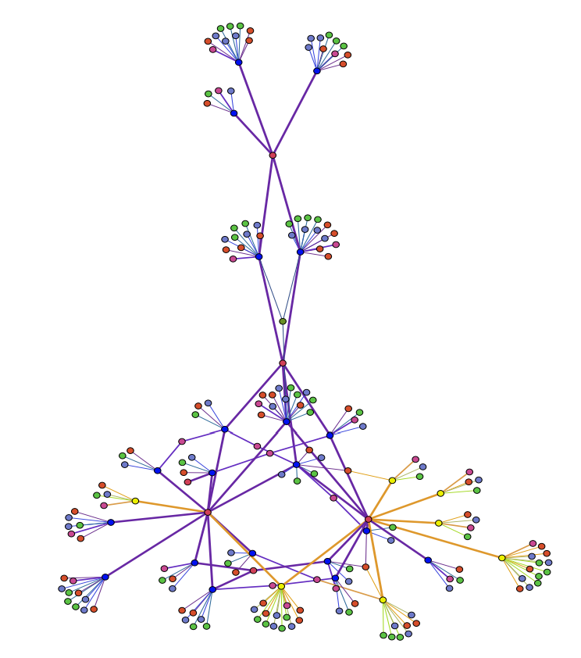
Graph ML is promising, and I want to try it…
So I found this fraud detection paper using graph neural networks [1] that looks quite impressive…
Normal accounts
Fraud accounts
[1] Heterogeneous Graph Neural Networks for Malicious Account Detection, Liu et al.

Slide 19
Graph ML is promising, and I want to try it…
MobileInfo
UserID | OS | AppVer | IP | Date
1 | iOS 15 | 2.0.2 | xx.xx.xx.xx | 2002/05/06
1 | iOS 15 | 2.0.2 | xx.xx.xx.xx | 2002/05/06
1 | iOS 15 | 2.0.2 | xx.xx.xx.xx | 2002/05/06
1 | iOS 15 | 2.0.2 | xx.xx.xx.xx | 2002/05/08
2 | Android 13 | 2.0.0 | xx.xx.xx.xx | 2002/05/09
So I found this fraud detection paper using graph neural networks [1] that looks quite impressive…
I want to predict whether a user is fraudulent at a particular day…
State
StateName | Area (km2)
New York | 141,297
Pennsylvania | 119,280
Michigan | 250,487
Users
UserID | Date | State | IsFraud
1 | 2002/05/06 | NY | True
2 | 2002/05/06 | PA | False
1 | 2002/05/08 | NY | N/A
2 | 2002/05/08 | PA | ?
3 | 2002/05/08 | MI | ?
CreditCard
CardID | CardNumber | ExpiryDate | Status
1001 | xxxxxxxxx | 2006/04/08 | 0
1002 | xxxxxxxxx | 2005/03/27 | 0
1003 | xxxxxxxxx | 2006/09/12 | 0
1004 | xxxxxxxxx | 2007/12/11 | 1
Topup
MerchantID | UserID | CardID | Amount | BrandID | Category | Date
A | 1 | 1001 | $20.00 | 111 | Food | 2002/05/06
B | 1 | 1003 | $8.00 | 222 | Book | 2002/05/08
A | 2 | 1002 | $23.00 | 111 | Food | 2002/05/08
B | 3 | 1001 | $8.50 | 333 | CD | 2002/05/08
[1] Heterogeneous Graph Neural Networks for Malicious Account Detection, Liu et al.
Notes:
Explain the tables

Slide 20
Graph ML is promising, and I want to try it…
MobileInfo
UserID | OS | AppVer | IP | Date
1 | iOS 15 | 2.0.2 | xx.xx.xx.xx | 2002/05/06
1 | iOS 15 | 2.0.2 | xx.xx.xx.xx | 2002/05/06
1 | iOS 15 | 2.0.2 | xx.xx.xx.xx | 2002/05/06
1 | iOS 15 | 2.0.2 | xx.xx.xx.xx | 2002/05/08
2 | Android 13 | 2.0.0 | xx.xx.xx.xx | 2002/05/09
State
StateName | Area (km2)
New York | 141,297
Pennsylvania | 119,280
Michigan | 250,487
?
Users
UserID | Date | State | IsFraud
1 | 2002/05/06 | NY | True
2 | 2002/05/06 | PA | False
1 | 2002/05/08 | NY | N/A
2 | 2002/05/08 | PA | ?
3 | 2002/05/08 | MI | ?
CreditCard
CardID | CardNumber | ExpiryDate | Status
1001 | xxxxxxxxx | 2006/04/08 | 0
1002 | xxxxxxxxx | 2005/03/27 | 0
1003 | xxxxxxxxx | 2006/09/12 | 0
1004 | xxxxxxxxx | 2007/12/11 | 1
Topup
MerchantID | UserID | CardID | Amount | BrandID | Category | Date
A | 1 | 1001 | $20.00 | 111 | Food | 2002/05/06
B | 1 | 1003 | $8.00 | 222 | Book | 2002/05/08
A | 2 | 1002 | $23.00 | 111 | Food | 2002/05/08
B | 3 | 1001 | $8.50 | 333 | CD | 2002/05/08
[1] Heterogeneous Graph Neural Networks for Malicious Account Detection, Liu et al.
Notes:
We are developers of DGL, one of the most popular graph machine learning libraries. We see more adoption of GNNs and we are happy. But those people from enterprises coming to us usually ask one of the questions we the DGL developers usually didn’t have ready answers: how should I build the graph? This is literally the question they ask us, because most of those people store their information in tables. We have no idea because we cannot actually see how their data looks like and we are unfamiliar with their business logic, and they have no idea because they are not familiar with graph machine learning.

Slide 21
Graph ML is promising, and I want to try it…
MobileInfo
UserID | OS | AppVer | IP | Date
1 | iOS 15 | 2.0.2 | xx.xx.xx.xx | 2002/05/06
1 | iOS 15 | 2.0.2 | xx.xx.xx.xx | 2002/05/06
1 | iOS 15 | 2.0.2 | xx.xx.xx.xx | 2002/05/06
1 | iOS 15 | 2.0.2 | xx.xx.xx.xx | 2002/05/08
2 | Android 13 | 2.0.0 | xx.xx.xx.xx | 2002/05/09
What GML does:
Predict a property of a node/edge.
But what we need:
Predict a value in a cell in a table.
State
StateName | Area (km2)
New York | 141,297
Pennsylvania | 119,280
Michigan | 250,487
Users
UserID | Date | State | IsFraud
1 | 2002/05/06 | NY | True
2 | 2002/05/06 | PA | False
1 | 2002/05/08 | NY | N/A
2 | 2002/05/08 | PA | ?
3 | 2002/05/08 | MI | ?
CreditCard
CardID | CardNumber | ExpiryDate | Status
1001 | xxxxxxxxx | 2006/04/08 | 0
1002 | xxxxxxxxx | 2005/03/27 | 0
1003 | xxxxxxxxx | 2006/09/12 | 0
1004 | xxxxxxxxx | 2007/12/11 | 1
Topup
MerchantID | UserID | CardID | Amount | BrandID | Category | Date
A | 1 | 1001 | $20.00 | 111 | Food | 2002/05/06
B | 1 | 1003 | $8.00 | 222 | Book | 2002/05/08
A | 2 | 1002 | $23.00 | 111 | Food | 2002/05/08
B | 3 | 1001 | $8.50 | 333 | CD | 2002/05/08
[1] Heterogeneous Graph Neural Networks for Malicious Account Detection, Liu et al.
Notes:
We are developers of DGL, one of the most popular graph machine learning libraries. We see more adoption of GNNs and we are happy. But those people from enterprises coming to us usually ask one of the questions we the DGL developers usually didn’t have ready answers: how should I build the graph? This is literally the question they ask us, because most of those people store their information in tables. We have no idea because we cannot actually see how their data looks like and we are unfamiliar with their business logic, and they have no idea because they are not familiar with graph machine learning.

Slide 22
Graph ML is promising, and I want to try it…
MobileInfo
UserID | OS | AppVer | IP | Date
1 | iOS 15 | 2.0.2 | xx.xx.xx.xx | 2002/05/06
1 | iOS 15 | 2.0.2 | xx.xx.xx.xx | 2002/05/06
1 | iOS 15 | 2.0.2 | xx.xx.xx.xx | 2002/05/06
1 | iOS 15 | 2.0.2 | xx.xx.xx.xx | 2002/05/08
2 | Android 13 | 2.0.0 | xx.xx.xx.xx | 2002/05/09
What GML does:
Predict a property of a node/edge.
But what we need:
Predict a value in a cell in a table.
State
StateName | Area (km2)
New York | 141,297
Pennsylvania | 119,280
Michigan | 250,487
?
Users
UserID | Date | State | IsFraud
1 | 2002/05/06 | NY | True
2 | 2002/05/06 | PA | False
1 | 2002/05/08 | NY | N/A
2 | 2002/05/08 | PA | ?
3 | 2002/05/08 | MI | ?
CreditCard
CardID | CardNumber | ExpiryDate | Status
1001 | xxxxxxxxx | 2006/04/08 | 0
1002 | xxxxxxxxx | 2005/03/27 | 0
1003 | xxxxxxxxx | 2006/09/12 | 0
1004 | xxxxxxxxx | 2007/12/11 | 1
Topup
MerchantID | UserID | CardID | Amount | BrandID | Category | Date
A | 1 | 1001 | $20.00 | 111 | Food | 2002/05/06
B | 1 | 1003 | $8.00 | 222 | Book | 2002/05/08
A | 2 | 1002 | $23.00 | 111 | Food | 2002/05/08
B | 3 | 1001 | $8.50 | 333 | CD | 2002/05/08
[1] Heterogeneous Graph Neural Networks for Malicious Account Detection, Liu et al.
Notes:
We are developers of DGL, one of the most popular graph machine learning libraries. We see more adoption of GNNs and we are happy. But those people from enterprises coming to us usually ask one of the questions we the DGL developers usually didn’t have ready answers: how should I build the graph? This is literally the question they ask us, because most of those people store their information in tables. We have no idea because we cannot actually see how their data looks like and we are unfamiliar with their business logic, and they have no idea because they are not familiar with graph machine learning.

Slide 23
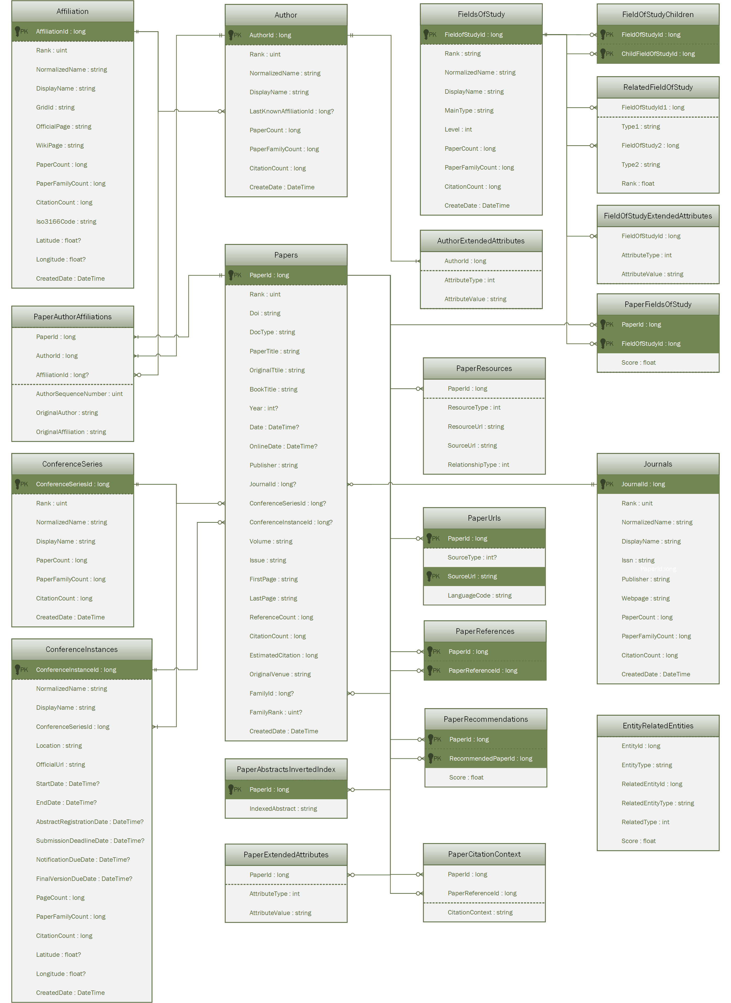
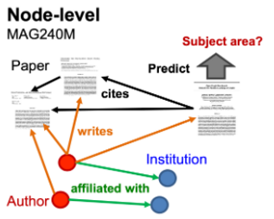
Graph ML is promising, and I want to try it…
[1] OGB-LSC https://ogb.stanford.edu/docs/lsc/

Slide 24
Applying Graph ML on Tables (as per a data scientist)

Slide 25
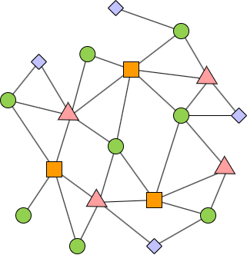
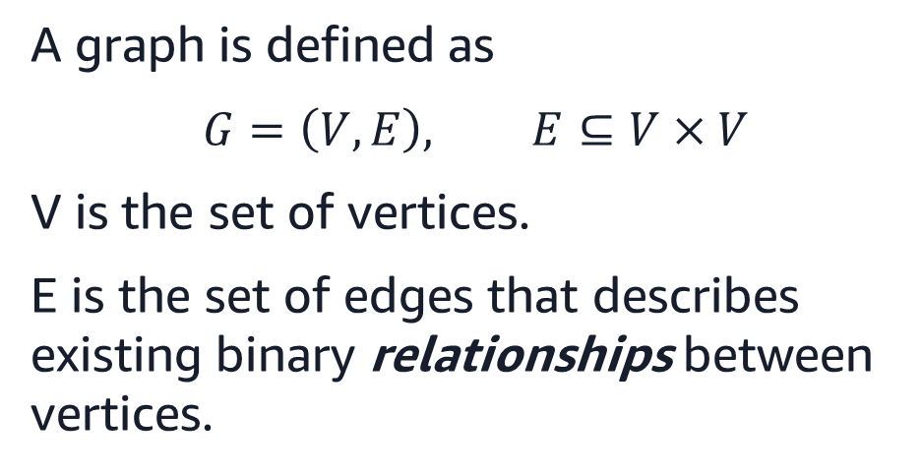
What does a graph describe?
A graph is defined as
$$G=\left(V, E\right), E⊆V×V$$
V is the set of vertices.
E is the set of edges that describes existing binary relationships between vertices.
Notes:
We ask the question: what are other things that describes relationships?
The vertices and edges can be attributed
TODO: add a bridge figure

Slide 26
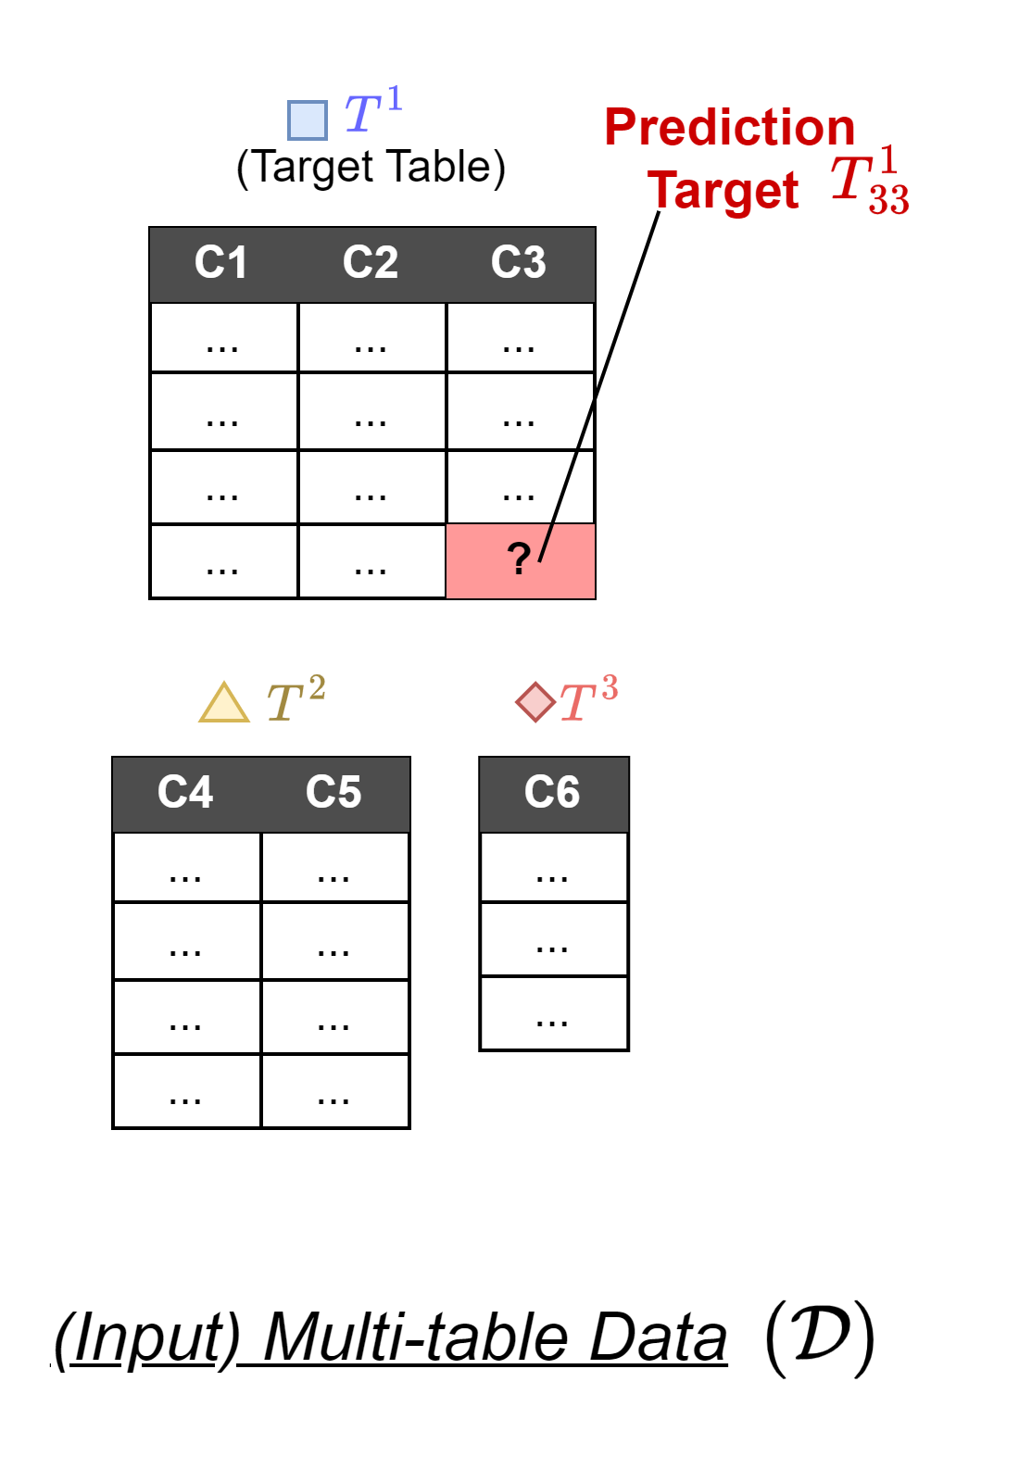
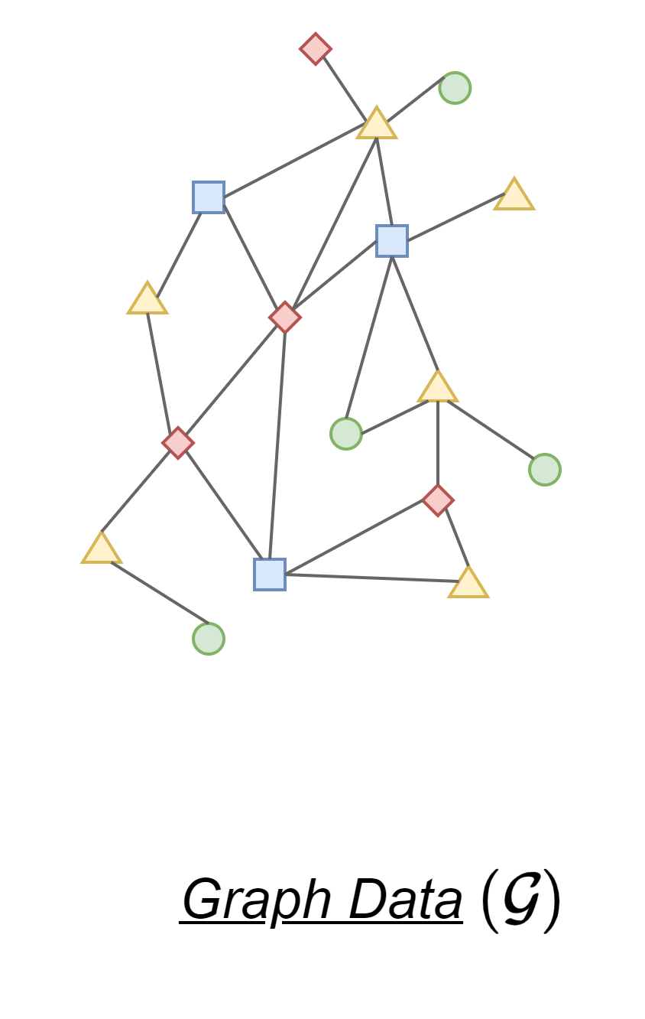
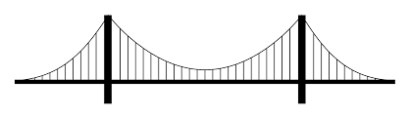
How to connect graphs and tables?
?

Slide 27
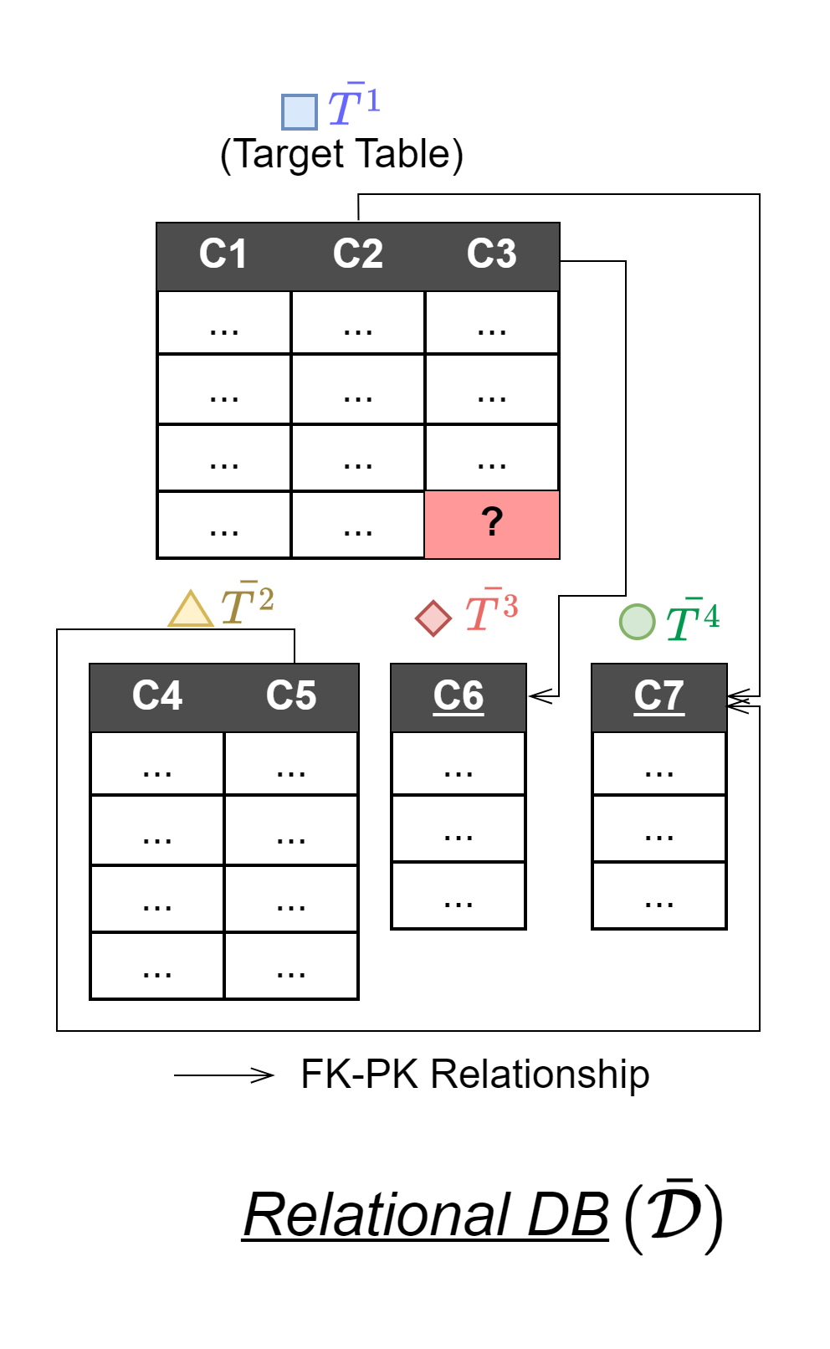
How to connect graphs and tables?

Slide 28
What is an RDB?
A relational database (RDB) is a collection of tables with additional constraints:
Some columns can be primary keys (PKs)
Unique identifier for each row in a table
Some columns can be foreign keys (FKs)
Unique identifier for a row in another table.
Other annotations like data types…
Not our focus today
CreditCard
CardID | CardNumber | ExpiryDate | Status
1001 | xxxxxxxxx | 2006/04/08 | 0
1002 | xxxxxxxxx | 2005/03/27 | 0
1003 | xxxxxxxxx | 2006/09/12 | 0
1004 | xxxxxxxxx | 2007/12/11 | 1
References
Topup
MerchantID | UserID | CardID | Amount | BrandID | Category | Date
A | 1 | 1001 | $20.00 | 111 | Food | 2002/05/06
B | 1 | 1003 | $8.00 | 222 | Book | 2002/05/08
A | 2 | 1002 | $23.00 | 111 | Food | 2002/05/08
B | 3 | 1001 | $8.50 | 333 | CD | 2002/05/08

Slide 29
Why RDB?
An RDB is already a set of tables…

Slide 30
Why RDB?
PKs and FKs of an RDB describe relationships between tables.
Notes:
PKs and FKs are the precursor of edges

Slide 31
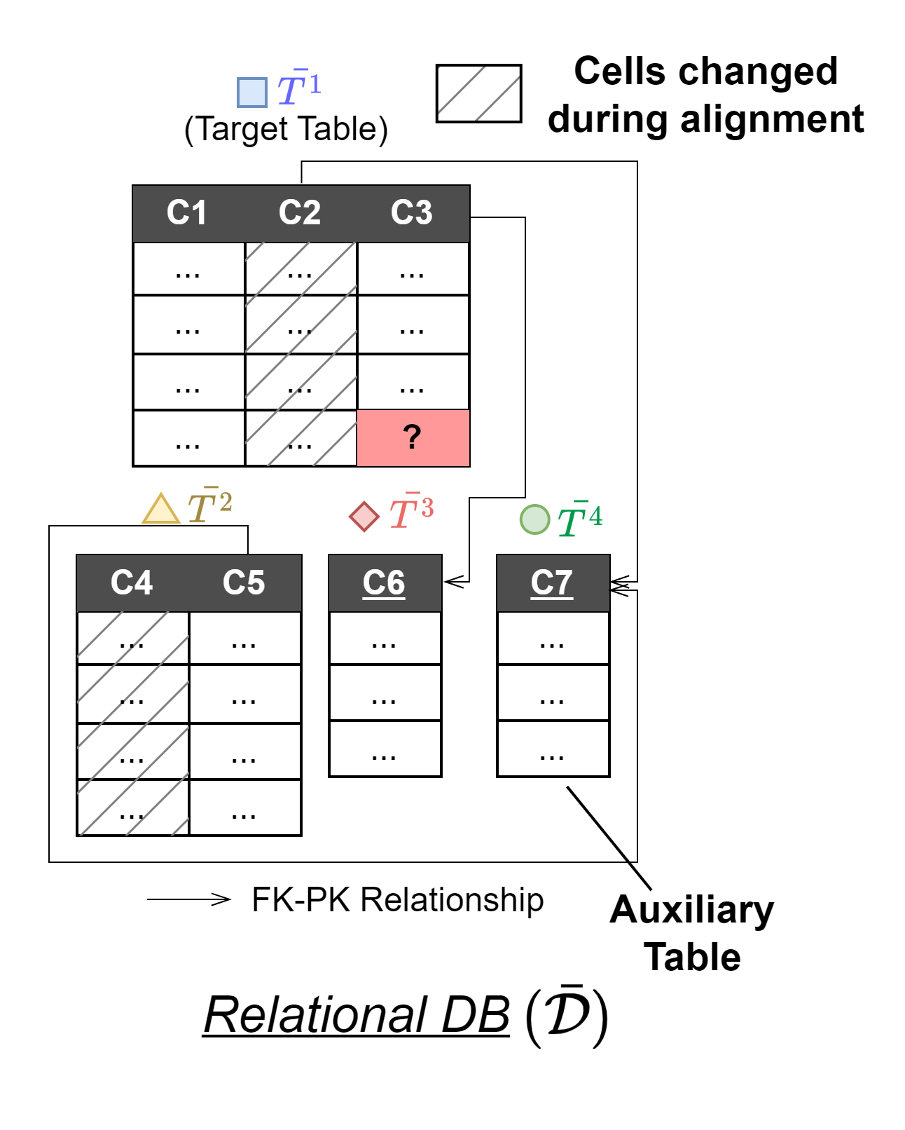
To build an RDB…
Prediction?

Slide 32
To build an RDB…
State
StateName | Area (km2)
New York | 141,297
Pennsylvania | 119,280
Michigan | 250,487
The core is to find PK-FKs.
Users
UserID | Date | State | IsFraud
1 | 2002/05/06 | NY | True
2 | 2002/05/06 | PA | False
1 | 2002/05/08 | NY | N/A
2 | 2002/05/08 | PA | ?
3 | 2002/05/08 | MI | ?
Topup
MerchantID | UserID | CardID | Amount | BrandID | Category | Date
A | 1 | 1001 | $20.00 | 111 | Food | 2002/05/06
B | 1 | 1003 | $8.00 | 222 | Book | 2002/05/08
A | 2 | 1002 | $23.00 | 111 | Food | 2002/05/08
B | 3 | 1001 | $8.50 | 333 | CD | 2002/05/08
CreditCard
CardID | CardNumber | ExpiryDate | Status
1001 | xxxxxxxxx | 2006/04/08 | 0
1002 | xxxxxxxxx | 2005/03/27 | 0
1003 | xxxxxxxxx | 2006/09/12 | 0
1004 | xxxxxxxxx | 2007/12/11 | 1
MobileInfo
UserID | OS | AppVer | IP | Date
1 | iOS 15 | 2.0.2 | xx.xx.xx.xx | 2002/05/06
1 | iOS 15 | 2.0.2 | xx.xx.xx.xx | 2002/05/06
1 | iOS 15 | 2.0.2 | xx.xx.xx.xx | 2002/05/06
1 | iOS 15 | 2.0.2 | xx.xx.xx.xx | 2002/05/08
2 | Android 13 | 2.0.0 | xx.xx.xx.xx | 2002/05/09

Slide 33
To build an RDB…
The core is to find PK-FKs.
Topup
MerchantID | UserID | CardID | Amount | BrandID | Category | Date
A | 1 | 1001 | $20.00 | 111 | Food | 2002/05/06
B | 1 | 1003 | $8.00 | 222 | Book | 2002/05/08
A | 2 | 1002 | $23.00 | 111 | Food | 2002/05/08
B | 3 | 1001 | $8.50 | 333 | CD | 2002/05/08
CreditCard
CardID | CardNumber | ExpiryDate | Status
1001 | xxxxxxxxx | 2006/04/08 | 0
1002 | xxxxxxxxx | 2005/03/27 | 0
1003 | xxxxxxxxx | 2006/09/12 | 0
1004 | xxxxxxxxx | 2007/12/11 | 1
Foreign key
References
Primary key

Slide 34
To build an RDB…
The core is to find PK-FKs.
But how?
Topup
MerchantID | UserID | CardID | Amount | BrandID | Category | Date
A | 1 | 1001 | $20.00 | 111 | Food | 2002/05/06
B | 1 | 1003 | $8.00 | 222 | Book | 2002/05/08
A | 2 | 1002 | $23.00 | 111 | Food | 2002/05/08
B | 3 | 1001 | $8.50 | 333 | CD | 2002/05/08
CreditCard
CardID | CardNumber | ExpiryDate | Status
1001 | xxxxxxxxx | 2006/04/08 | 0
1002 | xxxxxxxxx | 2005/03/27 | 0
1003 | xxxxxxxxx | 2006/09/12 | 0
1004 | xxxxxxxxx | 2007/12/11 | 1
Foreign key
References
Primary key
Notes:
Talk to people: sometimes these tables may be maintained by different people or even different teams.
Especially tedious if one has many tables.

Slide 35
To build an RDB…
The core is to find PK-FKs.
But how?
The column names usually do not match well…
Topup
MerchantID | UserID | cardNo | Amount | BrandID | Category | Date
A | 1 | xxxxxxxxx | $20.00 | 111 | Food | 2002/05/06
B | 1 | xxxxxxxxx | $8.00 | 222 | Book | 2002/05/08
A | 2 | xxxxxxxxx | $23.00 | 111 | Food | 2002/05/08
B | 3 | xxxxxxxxx | $8.50 | 333 | CD | 2002/05/08
CreditCard
CardID | CardNumber | ExpiryDate | Status
1001 | xxxxxxxxx | 2006/04/08 | 0
1002 | xxxxxxxxx | 2005/03/27 | 0
1003 | xxxxxxxxx | 2006/09/12 | 0
1004 | xxxxxxxxx | 2007/12/11 | 1
Notes:
In this example, you don’t have CardNumber in the topup table, but you have cardNo instead.
Common when these two tables are maintained by different teams or sources, which may have their own conventions.

Slide 36
To build an RDB…
The core is to find PK-FKs.
But how?
The column names usually do not match well…
In this example:
Card number as primary key?
Topup
MerchantID | UserID | cardNo | Amount | BrandID | Category | Date
A | 1 | xxxxxxxxx | $20.00 | 111 | Food | 2002/05/06
B | 1 | xxxxxxxxx | $8.00 | 222 | Book | 2002/05/08
A | 2 | xxxxxxxxx | $23.00 | 111 | Food | 2002/05/08
B | 3 | xxxxxxxxx | $8.50 | 333 | CD | 2002/05/08
CreditCard
CardID | CardNumber | ExpiryDate | Status
1001 | xxxxxxxxx | 2006/04/08 | 0
1002 | xxxxxxxxx | 2005/03/27 | 0
1003 | xxxxxxxxx | 2006/09/12 | 0
1004 | xxxxxxxxx | 2007/12/11 | 1
Foreign key?
References
Primary key?

Slide 37
To build an RDB…
State
StateName | Area (km2)
New York | 141,297
Pennsylvania | 119,280
Michigan | 250,487
The core is to find PK-FKs.
Users
UserID | Date | State | IsFraud
1 | 2002/05/06 | NY | True
2 | 2002/05/06 | PA | False
1 | 2002/05/08 | NY | N/A
2 | 2002/05/08 | PA | ?
3 | 2002/05/08 | MI | ?
Topup
MerchantID | UserID | CardID | Amount | BrandID | Category | Date
A | 1 | 1001 | $20.00 | 111 | Food | 2002/05/06
B | 1 | 1003 | $8.00 | 222 | Book | 2002/05/08
A | 2 | 1002 | $23.00 | 111 | Food | 2002/05/08
B | 3 | 1001 | $8.50 | 333 | CD | 2002/05/08
CreditCard
CardID | CardNumber | ExpiryDate | Status
1001 | xxxxxxxxx | 2006/04/08 | 0
1002 | xxxxxxxxx | 2005/03/27 | 0
1003 | xxxxxxxxx | 2006/09/12 | 0
1004 | xxxxxxxxx | 2007/12/11 | 1
MobileInfo
UserID | OS | AppVer | IP | Date
1 | iOS 15 | 2.0.2 | xx.xx.xx.xx | 2002/05/06
1 | iOS 15 | 2.0.2 | xx.xx.xx.xx | 2002/05/06
1 | iOS 15 | 2.0.2 | xx.xx.xx.xx | 2002/05/06
1 | iOS 15 | 2.0.2 | xx.xx.xx.xx | 2002/05/08
2 | Android 13 | 2.0.0 | xx.xx.xx.xx | 2002/05/09

Slide 38
To build an RDB…
State
StateName | Area (km2)
New York | 141,297
Pennsylvania | 119,280
Michigan | 250,487
The core is to find PK-FKs.
What if the values don’t exactly match?
Users
UserID | Date | State | IsFraud
1 | 2002/05/06 | NY | True
2 | 2002/05/06 | PA | False
1 | 2002/05/08 | NY | N/A
2 | 2002/05/08 | PA | ?
3 | 2002/05/08 | MI | ?
Primary key?
References
Foreign key?

Slide 39
To build an RDB…
State
StateName | Area (km2)
NY | 141,297
PA | 119,280
MI | 250,487
The core is to find PK-FKs.
What if the values don’t exactly match?
Need to align values (e.g. “New York” = “NY”, “Pennsylvania” = “PA”, etc.)
But how?
Users
UserID | Date | State | IsFraud
1 | 2002/05/06 | NY | True
2 | 2002/05/06 | PA | False
1 | 2002/05/08 | NY | N/A
2 | 2002/05/08 | PA | ?
3 | 2002/05/08 | MI | ?
Primary key
References
Foreign key

Slide 40
To build an RDB…
The core is to find PK-FKs.
Users
UserID | Date | State | IsFraud
1 | 2002/05/06 | NY | True
2 | 2002/05/06 | PA | False
1 | 2002/05/08 | NY | N/A
2 | 2002/05/08 | PA | ?
3 | 2002/05/08 | MI | ?
Topup
MerchantID | UserID | CardID | Amount | BrandID | Category | Date
A | 1 | 1001 | $20.00 | 111 | Food | 2002/05/06
B | 1 | 1003 | $8.00 | 222 | Book | 2002/05/08
A | 2 | 1002 | $23.00 | 111 | Food | 2002/05/08
B | 3 | 1001 | $8.50 | 333 | CD | 2002/05/08
MobileInfo
UserID | OS | AppVer | IP | Date
1 | iOS 15 | 2.0.2 | xx.xx.xx.xx | 2002/05/06
1 | iOS 15 | 2.0.2 | xx.xx.xx.xx | 2002/05/06
1 | iOS 15 | 2.0.2 | xx.xx.xx.xx | 2002/05/06
1 | iOS 15 | 2.0.2 | xx.xx.xx.xx | 2002/05/08
2 | Android 13 | 2.0.0 | xx.xx.xx.xx | 2002/05/09

Slide 41
To build an RDB…
The core is to find PK-FKs.
Users
UserID | Date | State | IsFraud
1 | 2002/05/06 | NY | True
2 | 2002/05/06 | PA | False
1 | 2002/05/08 | NY | N/A
2 | 2002/05/08 | PA | ?
3 | 2002/05/08 | MI | ?
Topup
MerchantID | UserID | CardID | Amount | BrandID | Category | Date
A | 1 | 1001 | $20.00 | 111 | Food | 2002/05/06
B | 1 | 1003 | $8.00 | 222 | Book | 2002/05/08
A | 2 | 1002 | $23.00 | 111 | Food | 2002/05/08
B | 3 | 1001 | $8.50 | 333 | CD | 2002/05/08
NOT a primary key!
MobileInfo
UserID | OS | AppVer | IP | Date
1 | iOS 15 | 2.0.2 | xx.xx.xx.xx | 2002/05/06
1 | iOS 15 | 2.0.2 | xx.xx.xx.xx | 2002/05/06
1 | iOS 15 | 2.0.2 | xx.xx.xx.xx | 2002/05/06
1 | iOS 15 | 2.0.2 | xx.xx.xx.xx | 2002/05/08
2 | Android 13 | 2.0.0 | xx.xx.xx.xx | 2002/05/09

Slide 42
To build an RDB…
The core is to find PK-FKs.
Sometimes the relation cannot be expressed as a PK-FK relationship…
Users
UserID | Date | State | IsFraud
1 | 2002/05/06 | NY | True
2 | 2002/05/06 | PA | False
1 | 2002/05/08 | NY | N/A
2 | 2002/05/08 | PA | ?
3 | 2002/05/08 | MI | ?
Topup
MerchantID | UserID | CardID | Amount | BrandID | Category | Date
A | 1 | 1001 | $20.00 | 111 | Food | 2002/05/06
B | 1 | 1003 | $8.00 | 222 | Book | 2002/05/08
A | 2 | 1002 | $23.00 | 111 | Food | 2002/05/08
B | 3 | 1001 | $8.50 | 333 | CD | 2002/05/08
MobileInfo
UserID | OS | AppVer | IP | Date
1 | iOS 15 | 2.0.2 | xx.xx.xx.xx | 2002/05/06
1 | iOS 15 | 2.0.2 | xx.xx.xx.xx | 2002/05/06
1 | iOS 15 | 2.0.2 | xx.xx.xx.xx | 2002/05/06
1 | iOS 15 | 2.0.2 | xx.xx.xx.xx | 2002/05/08
2 | Android 13 | 2.0.0 | xx.xx.xx.xx | 2002/05/09

Slide 43
To build an RDB…
The core is to find PK-FKs.
… unless we create auxiliary tables.
But how?
Users
UserID | Date | State | IsFraud
1 | 2002/05/06 | NY | True
2 | 2002/05/06 | PA | False
1 | 2002/05/08 | NY | N/A
2 | 2002/05/08 | PA | ?
3 | 2002/05/08 | MI | ?
Topup
MerchantID | BuyerID | CardID | Amount | BrandID | Category | Date
A | 1 | 1001 | $20.00 | 111 | Food | 2002/05/06
B | 1 | 1003 | $8.00 | 222 | Book | 2002/05/08
A | 2 | 1002 | $23.00 | 111 | Food | 2002/05/08
B | 3 | 1001 | $8.50 | 333 | CD | 2002/05/08
FK
User
UserID
1
2
3
FK
MobileInfo
UserID | OS | AppVer | IP | Date
1 | iOS 15 | 2.0.2 | xx.xx.xx.xx | 2002/05/06
1 | iOS 15 | 2.0.2 | xx.xx.xx.xx | 2002/05/06
1 | iOS 15 | 2.0.2 | xx.xx.xx.xx | 2002/05/06
1 | iOS 15 | 2.0.2 | xx.xx.xx.xx | 2002/05/08
2 | Android 13 | 2.0.0 | xx.xx.xx.xx | 2002/05/09
Primary key
FK

Slide 44
To build an RDB…
The core is to find PK-FKs.
Sometimes we want to model interdependencies between rows in the same table.
But there is a lot of freedom…
Topup
MerchantID | UserID | CardID | Amount | BrandID | Category | Date
A | 1 | 1001 | $20.00 | 111 | Food | 2002/05/06
B | 1 | 1003 | $8.00 | 222 | Book | 2002/05/08
A | 2 | 1002 | $23.00 | 111 | Food | 2002/05/08
B | 3 | 1001 | $8.50 | 333 | CD | 2002/05/08

Slide 45
To build an RDB…
The core is to find PK-FKs.
Sometimes we want to model interdependencies between rows in the same table.
But there is a lot of freedom…
Topup
MerchantID | UserID | CardID | Amount | BrandID | Category | Date
A | 1 | 1001 | $20.00 | 111 | Food | 2002/05/06
B | 1 | 1003 | $8.00 | 222 | Book | 2002/05/08
A | 2 | 1002 | $23.00 | 111 | Food | 2002/05/08
B | 3 | 1001 | $8.50 | 333 | CD | 2002/05/08
Merchant
MerchantID
A
B

Slide 46
To build an RDB…
The core is to find PK-FKs.
Sometimes we want to model interdependencies between rows in the same table.
But there is a lot of freedom…
Topup
MerchantID | UserID | CardID | Amount | BrandID | Category | Date
A | 1 | 1001 | $20.00 | 111 | Food | 2002/05/06
B | 1 | 1003 | $8.00 | 222 | Book | 2002/05/08
A | 2 | 1002 | $23.00 | 111 | Food | 2002/05/08
B | 3 | 1001 | $8.50 | 333 | CD | 2002/05/08

Slide 47
To build an RDB…
The core is to find PK-FKs.
Sometimes we want to model interdependencies between rows in the same table.
But there is a lot of freedom…
Topup
ProductID | UserID | CardID | Amount | Date
P1 | 1 | 1001 | $20.00 | 2002/05/06
P2 | 1 | 1003 | $8.00 | 2002/05/08
P1 | 2 | 1002 | $23.00 | 2002/05/08
P3 | 3 | 1001 | $8.50 | 2002/05/08
Product | Product
ProductID | MerchantID | BrandID | Category
P1 | A | 111 | Food
P2 | B | 222 | Book
P3 | B | 333 | CD

Slide 48
To build an RDB…
The core is to find PK-FKs.
Sometimes we want to model interdependencies between rows in the same table.
But there is a lot of freedom…
Topup
ProductID | UserID | CardID | Amount | Date
P1 | 1 | 1001 | $20.00 | 2002/05/06
P2 | 1 | 1003 | $8.00 | 2002/05/08
P1 | 2 | 1002 | $23.00 | 2002/05/08
P3 | 3 | 1001 | $8.50 | 2002/05/08
Product | Product
ProductID | MerchantID | BrandID | Category
P1 | A | 111 | Food
P2 | B | 222 | Book
P3 | B | 333 | CD
Merchant
MerchantID
A
B

Slide 49
To build an RDB…
The core is to find PK-FKs.
Sometimes we want to model interdependencies between rows in the same table.
But there is a lot of freedom…
Should we treat a column as an attribute or a foreign key?
Topup
MerchantID | UserID | CardID | Amount | BrandID | Category | Date
A | 1 | 1001 | $20.00 | 111 | Food | 2002/05/06
B | 1 | 1003 | $8.00 | 222 | Book | 2002/05/08
A | 2 | 1002 | $23.00 | 111 | Food | 2002/05/08
B | 3 | 1001 | $8.50 | 333 | CD | 2002/05/08
?
Category
Category
Food
Book
Food
Notes:
What is the standard?

Slide 50
To build an RDB…
The core is to find PK-FKs.
Sometimes we want to model interdependencies between rows in the same table.
But there is a lot of freedom…
Should we treat a column as an attribute or a foreign key?
Transductive (the domain is fixed)
Inductive (the domain may grow)
Topup
MerchantID | UserID | CardID | Amount | BrandID | Category | Date
A | 1 | 1001 | $20.00 | 111 | Food | 2002/05/06
B | 1 | 1003 | $8.00 | 222 | Book | 2002/05/08
A | 2 | 1002 | $23.00 | 111 | Food | 2002/05/08
B | 3 | 1001 | $8.50 | 333 | CD | 2002/05/08
?
Category
Category
Food
Book
Food

Slide 51
To build a graph…
Prediction?

Slide 52
To build a graph…
PK-FKs naturally describe relationships.
Topup
MerchantID | UserID | CardID | Amount | BrandID | Category | Date
A | 1 | 1001 | $20.00 | 111 | Food | 2002/05/06
B | 1 | 1003 | $8.00 | 222 | Book | 2002/05/08
A | 2 | 1002 | $23.00 | 111 | Food | 2002/05/08
B | 3 | 1001 | $8.50 | 333 | CD | 2002/05/08
CreditCard
CardID | CardNumber | ExpiryDate | Status
1001 | xxxxxxxxx | 2006/04/08 | 0
1002 | xxxxxxxxx | 2005/03/27 | 0
1003 | xxxxxxxxx | 2006/09/12 | 0
1004 | xxxxxxxxx | 2007/12/11 | 1
Foreign key
References
Primary key

Slide 53
To build a graph…
PK-FKs naturally describe relationships.
Treat each row as a node and each PK-FK reference as an edge.
Topup
MerchantID | UserID | CardID | Amount | BrandID | Category | Date
A | 1 | 1001 | $20.00 | 111 | Food | 2002/05/06
B | 1 | 1003 | $8.00 | 222 | Book | 2002/05/08
A | 2 | 1002 | $23.00 | 111 | Food | 2002/05/08
B | 3 | 1001 | $8.50 | 333 | CD | 2002/05/08
CreditCard
CardID | CardNumber | ExpiryDate | Status
1001 | xxxxxxxxx | 2006/04/08 | 0
1002 | xxxxxxxxx | 2005/03/27 | 0
1003 | xxxxxxxxx | 2006/09/12 | 0
1004 | xxxxxxxxx | 2007/12/11 | 1
[1] Supervised Learning on Relational Databases with Graph Neural Networks, Milan Cvitkovic

Slide 54
To build a graph…
PK-FKs naturally describe relationships.
Treat each row as a node and each PK-FK reference as an edge.
But can we do better?
Paper
PaperID | ReviewScore
1001 | 6.5
1002 | 8
1003 | 6.5
1004 | 7
Writes
PaperID | AuthorID
1001 | 1
1003 | 2
1002 | 3
1001 | 4
1004 | 4
Author
AuthorID | Country
1 | US
2 | China
3 | Spain
4 | Japan

Slide 55
To build a graph…
PK-FKs naturally describe relationships.
Treat each row as a node and each PK-FK reference as an edge.
But can we do better?
Writes
PaperID | AuthorID
1001 | 1
1003 | 2
1002 | 3
1001 | 4
1004 | 4
Paper
PaperID | ReviewScore
1001 | 6.5
1002 | 8
1003 | 6.5
1004 | 7
Author
AuthorID | Country
1 | US
2 | China
3 | Spain
4 | Japan

Slide 56
To build a graph…
PK-FKs naturally describe relationships.
Treat each row as a node and each PK-FK reference as an edge.
But can we do better?
More-than-binary relationships?
Documents
DocID | Category
1001 | A
1002 | B
1003 | C
1004 | D
Ad
AdID | Site
111 | Youtube
222 | Twitter
333 | Twitter
444 | Facebook
Users
UUID | Country
1 | US
2 | China
3 | Spain
4 | Japan
Clicks
AdID | DocID | UserID
111 | 1001 | 1
222 | 1002 | 2
333 | 1003 | 3
444 | 1004 | 4

Slide 57
To build a graph…
PK-FKs naturally describe relationships.
Treat each row as a node and each PK-FK reference as an edge.
But can we do better?
More-than-binary relationships?
Hypergraph??
Ad
Doc
Ad

Slide 58
To build a graph…
PK-FKs naturally describe relationships.
Treat each row as a node and each PK-FK reference as an edge.
But can we do better?
More-than-binary relationships?
High-order?
Exposure | Exposure
ExposureID | AdID | DocID
AAA | 111 | 1001
BBB | 222 | 1002
CCC | 333 | 1003
DDD | 444 | 1004
Documents
DocID | Category
1001 | A
1002 | B
1003 | C
1004 | D
Ad
AdID | Site
111 | Youtube
222 | Twitter
333 | Twitter
444 | Facebook
Users
UUID | Country
1 | US
2 | China
3 | Spain
4 | Japan
Clicks
ExposureID | UserID
AAA | 1
BBB | 2
CCC | 3
DDD | 4

Slide 59
To build a graph…
Lots of manual work even before we start training a Graph ML model.
Prediction?

Slide 60
Is there an ideal graph?
MobileInfo
UserID | OS | AppVer | IP | Date
1 | iOS 15 | 2.0.2 | xx.xx.xx.xx | 2002/05/06
1 | iOS 15 | 2.0.2 | xx.xx.xx.xx | 2002/05/06
1 | iOS 15 | 2.0.2 | xx.xx.xx.xx | 2002/05/06
1 | iOS 15 | 2.0.2 | xx.xx.xx.xx | 2002/05/08
2 | Android 13 | 2.0.0 | xx.xx.xx.xx | 2002/05/09
State
StateName | Area (km2)
New York | 141,297
Pennsylvania | 119,280
Michigan | 250,487
Users
UserID | Date | State | IsFraud
1 | 2002/05/06 | NY | True
2 | 2002/05/06 | PA | False
1 | 2002/05/08 | NY | N/A
2 | 2002/05/08 | PA | ?
3 | 2002/05/08 | MI | ?
CreditCard
CardID | CardNumber | ExpiryDate | Status
1001 | xxxxxxxxx | 2006/04/08 | 0
1002 | xxxxxxxxx | 2005/03/27 | 0
1003 | xxxxxxxxx | 2006/09/12 | 0
1004 | xxxxxxxxx | 2007/12/11 | 1
Topup
MerchantID | UserID | CardID | Amount | BrandID | Category | Date
A | 1 | 1001 | $20.00 | 111 | Food | 2002/05/06
B | 1 | 1003 | $8.00 | 222 | Book | 2002/05/08
A | 2 | 1002 | $23.00 | 111 | Food | 2002/05/08
B | 3 | 1001 | $8.50 | 333 | CD | 2002/05/08

Slide 61
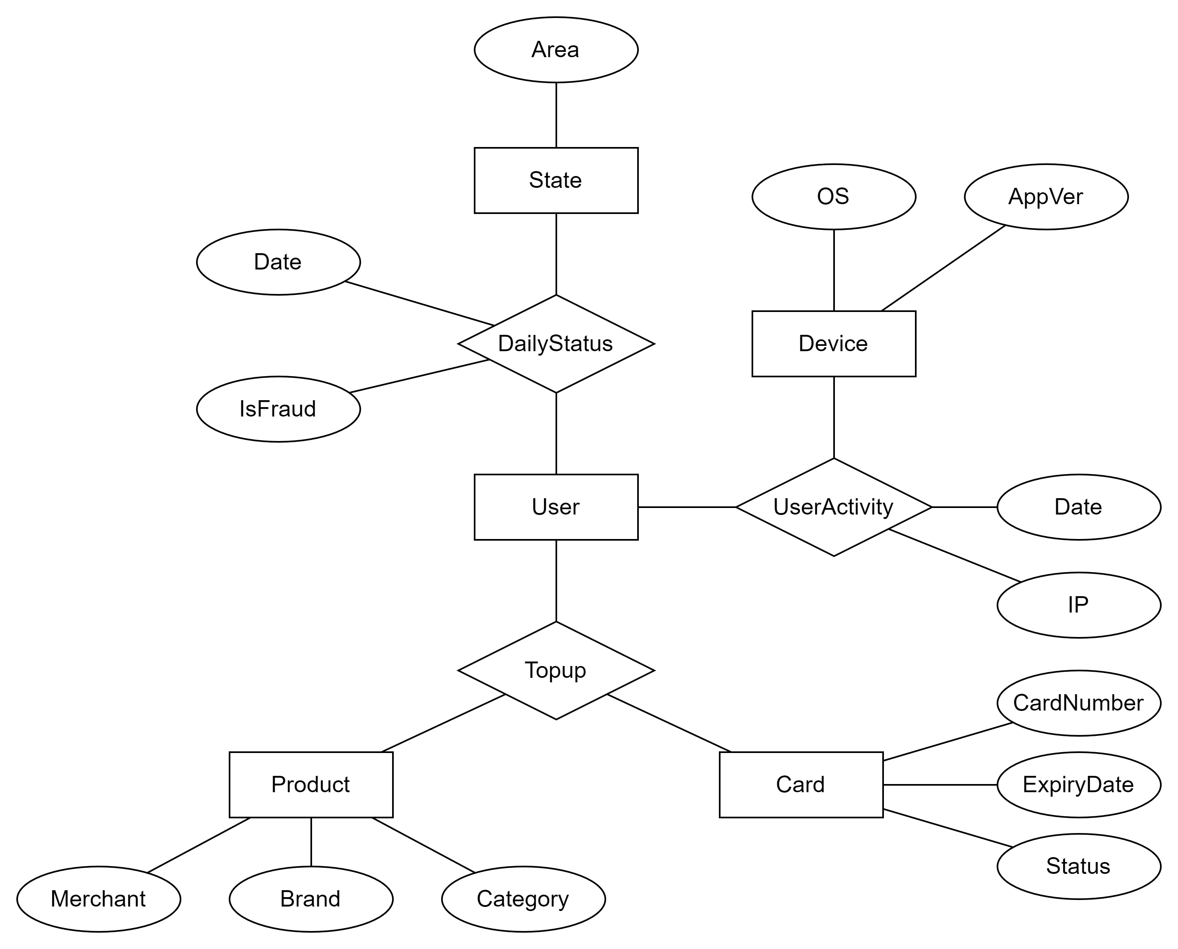
Is there an ideal graph?
Multi-tables are usually a surface form of a latent data model.
An analogy for RDB design is Entity-Relationship Diagram (ERD)
Facilitates graph construction
Entities → Nodes
Relationships → (Hyper)edges
Not always available
Ambiguous
Especially if data is maintained by different teams/sources
Even available, is it the best for downstream task?
Notes:
Users table actually represents the daily status of each user.
The MobileInfo table actually records the user’s activity on their mobile device, which are identified by OS, App version, MAC address, etc.
I actually merged the attributes of the products into the Topup table to save time for database queries etc.
(Go through the first point)
The actual tables or RDBs may not reflect the underlying “mind” model for the business logic. That’s because the database designers have other objectives to optimize, for instance, query speed and throughput, etc.
Especially if data is maintained by different sources, for instance, joining your own knowledge graph with WikiData. The procedure of “joining” in this case is called Reconciliation.

Slide 62
Finally we have a graph, what next?
Prediction?

Slide 63
Finally we have a graph, what next?
How to encode attributes?
Categorical, numeric, text, image, …
UserReviews
UserID | ItemID | Review | Rating
1 | A | Great product | 5
2 | B | Not great but good enough | 4
3 | C | Mediocre | 3
4 | D | I don’t like this | 2

Slide 64
Finally we have a graph, what next?
How to encode attributes?
How to pick an appropriate backbone?

Slide 65
Finally we have a graph, what next?
How to encode attributes?
How to pick an appropriate backbone?

Slide 66
Finally we have a graph, what next?
MobileInfo
UserID | OS | AppVer | IP | Date
1 | iOS 15 | 2.0.2 | xx.xx.xx.xx | 2002/05/06
1 | iOS 15 | 2.0.2 | xx.xx.xx.xx | 2002/05/06
1 | iOS 15 | 2.0.2 | xx.xx.xx.xx | 2002/05/06
1 | iOS 15 | 2.0.2 | xx.xx.xx.xx | 2002/05/08
2 | Android 13 | 2.0.0 | xx.xx.xx.xx | 2002/05/09
Users
UserID | Date | State | IsFraud
1 | 2002/05/06 | NY | True
2 | 2002/05/06 | PA | False
1 | 2002/05/08 | NY | N/A
2 | 2002/05/08 | PA | ?
3 | 2002/05/08 | MI | ?
User
UserID
1
2
3
CreditCard
CardID | CardNumber | ExpiryDate | Status
1001 | xxxxxxxxx | 2006/04/08 | 0
1002 | xxxxxxxxx | 2005/03/27 | 0
1003 | xxxxxxxxx | 2006/09/12 | 0
1004 | xxxxxxxxx | 2007/12/11 | 1
Topup
MerchantID | UserID | CardID | Amount | Date
A | 1 | 1001 | 20.00 | 2002/05/06
B | 1 | 1003 | 8.00 | 2002/05/08
A | 2 | 1002 | 23.00 | 2002/05/08
B | 3 | 1001 | 8.50 | 2002/05/08
Merchant
MerchantID
A
B

Slide 67
Finally we have a graph, what next?
How to encode attributes?
How to pick an appropriate backbone?
Manual/automated feature engineering (e.g. aggregating the features along PK-FKs first)?
AugmentedFraudulentUsers |  |  |  |  | FraudulentUsers
… | COUNT(User.MobileInfo) | COUNT(User.Topup.CardID) | MAX(User.Topup.Amount) | SUM(User.Topup.Amount) | UserID | Date | Country | IsFraud
… | 3 | 1 | 20 | 20 | 1 | 2002/05/06 | US | True
… | 0 | 0 | 0 | 0 | 2 | 2002/05/06 | US | False
… | 4 | 2 | 20 | 28 | 1 | 2002/05/08 | US | False
… | 0 | 1 | 23 | 23 | 2 | 2002/05/08 | US | ?
… | 0 | 1 | 8.5 | 8.5 | 3 | 2002/05/08 | Japan | ?

Slide 68
Finally we have a graph, what next?
How to encode attributes?
How to pick an appropriate backbone?
Neural networks on graphs (message passing neural nets, transformers, …)?

Slide 69
Finally we have a graph, what next?
How to encode attributes?
How to pick an appropriate backbone?
How to deal with timestamps during training?
MobileInfo
UserID | OS | AppVer | IP | Date
1 | iOS 15 | 2.0.2 | xx.xx.xx.xx | 2002/05/06
1 | iOS 15 | 2.0.2 | xx.xx.xx.xx | 2002/05/06
1 | iOS 15 | 2.0.2 | xx.xx.xx.xx | 2002/05/06
1 | iOS 15 | 2.0.2 | xx.xx.xx.xx | 2002/05/08
2 | Android 13 | 2.0.0 | xx.xx.xx.xx | 2002/05/09
Users
UserID | Date | State | IsFraud
1 | 2002/05/06 | NY | True
2 | 2002/05/06 | PA | False
1 | 2002/05/08 | NY | N/A
2 | 2002/05/08 | PA | ?
3 | 2002/05/08 | MI | ?

Slide 70
Finally we have a graph, what next?
How to encode attributes?
How to pick an appropriate backbone?
How to deal with timestamps during training?
MobileInfo
UserID | OS | AppVer | IP | Date
1 | iOS 15 | 2.0.2 | xx.xx.xx.xx | 2002/05/06
1 | iOS 15 | 2.0.2 | xx.xx.xx.xx | 2002/05/06
1 | iOS 15 | 2.0.2 | xx.xx.xx.xx | 2002/05/06
1 | iOS 15 | 2.0.2 | xx.xx.xx.xx | 2002/05/08
2 | Android 13 | 2.0.0 | xx.xx.xx.xx | 2002/05/09
Users
UserID | Date | State | IsFraud
1 | 2002/05/06 | NY | True
2 | 2002/05/06 | PA | False
1 | 2002/05/08 | NY | N/A
2 | 2002/05/08 | PA | ?
3 | 2002/05/08 | MI | ?

Slide 71
Finally we have a graph, what next?
How to encode attributes?
How to pick an appropriate backbone?
How to deal with timestamps during training?
How to deal with label leakage during training?
UserReviews
UserID | ItemID | Review | Rating
1 | A | Great product | 5
2 | B | Not great but good enough | 4
3 | C | Mediocre | 3
4 | D | I don’t like this | 2

Slide 72
Finally we have a graph, what next?
How to encode attributes?
How to pick an appropriate backbone?
How to deal with timestamps during training?
How to deal with label leakage during training?
UserReviews
UserID | ItemID | Review | Rating
1 | A | Great product | 5
2 | B | Not great but good enough | 4
3 | C | Mediocre | 3
4 | D | I don’t like this | 2
Notes:
Why you cannot use the review column? Because when predicting the rating a user gives to an item during test time or deployment, the review is usually not available yet.

Slide 73
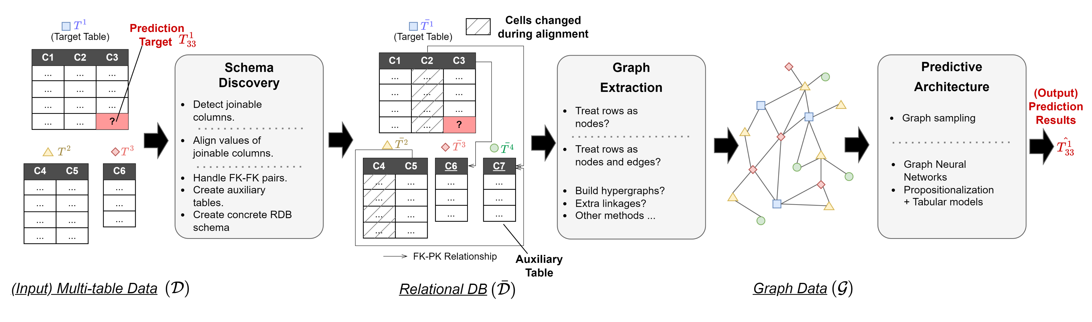
To sum up…

Slide 74
Coffee break

Slide 75
Graph Machine Learning Meets Multi-Table Relational Data (Pt. 2)
Quan Gan, Minjie Wang
David Wipf, Christos Faloutsos
Accompanying survey paper

Slide 76
Agenda
First half
What is Graph ML?
How to apply Graph ML on multi-tables?
Coffee break (20 min)
Second half
What are the options for each step?
What are the benchmarks?
What are the future directions?

Slide 77
Using GML for your multi-table data

Slide 78
01
02
Schema Discovery
Graph Construction
03
04
Predictive Architecture
Resources & Future Directions

Slide 79
01
02
Schema Discovery
Graph Construction
03
04
Predictive Architecture
Resources & Future Directions

Slide 80
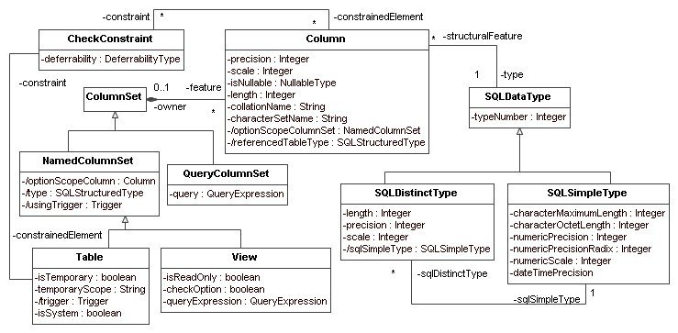
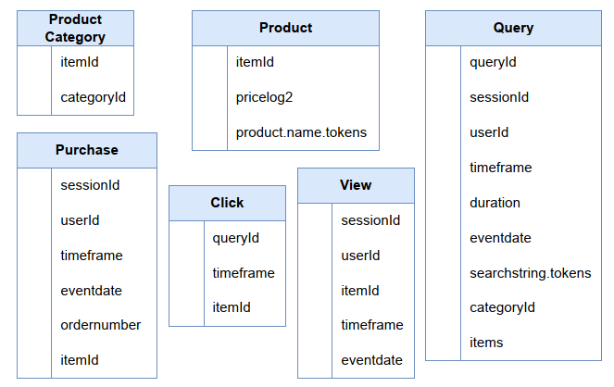
Ambiguity in real-world multi-table data
Ideal Data: rigorously-defined schema, data types, no ambiguity
Real Data: often no schema and data type annotation, fuzzy or spurious values, high ambiguity
Strategy: Converting to RDB helps resolve ambiguity

Slide 81
Steps to convert multi-table data into an RDB
Join Discovery (JD): Finding joinable relationships between tables.
Join Alignment (JA): Align values in joinable columns to create PK/FK or FK/FK pairs.
Form RDB Schema: Convert FK/FK pairs to PK/FK pairs, combine with existing PK/FK pairs to form schema.
Multi-table Data
Join Discovery
Join Alignment
Form RDB Schema
RDB

Slide 82
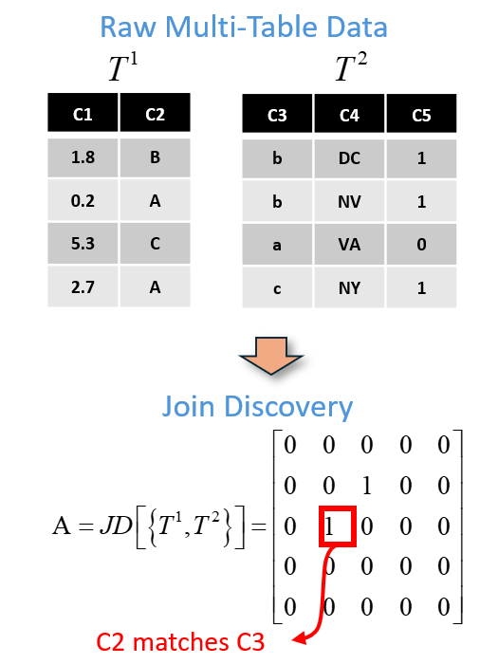
Join Discovery
Form N x N adjacency matrix A, where N is total number of table columns.
A_{ij} =1 if columns i and j are joinable, equals 0 otherwise.
Note: columns i and j are generally in different tables (although not always).

Slide 83
Join Discovery Methods
Typically based on similarity measures applied to:
Column labels (e.g., reasonable to join columns with shared names)
Column contents (e.g., search for overlapping column distributions)
Increasingly based on large language models (e.g., transforming column contents to text sequences for comparison, etc.)
Auto-Fuzzyjoin: Auto-Program Fuzzy Similarity Joins Without Labeled Examples, Li et al.
Fast-Join: An Efficient Method for Fuzzy Token Matching based String Simiarity Join, Want et al.
Customizable and Scalable Fuzzy Join for Big Data, Chen et al.
DeepJoin: Joinable Table Discovery with Pre-Trained Language Models, Dong et al.

Slide 84
Join Alignment
Input: Pair of joinable columns C_{i} and C_{j}, meaning Aij = 1.
Output: PK/FK pair or FK/FK pair.
Criteria:
If column domains match, and one has all unique values
If column domains match, but no PK
Otherwise, apply fuzzy alignment methods (harder)
PK/FK pair
FK/FK pair
Domain mismatch
Map to matched domain
PK/FK pair
FK/FK pair
C_{i}
a
b
c
C_{j}
b
a
c
a
C_{i}
b
b
a
C_{j}
b
a
c
a
C_{j}
B
A
C
A
C_{i}
a
b
c
Equi-Join Cases
(easier)
Fuzzy-Join
(harder)
?
Now follow equi-join case …

Slide 85
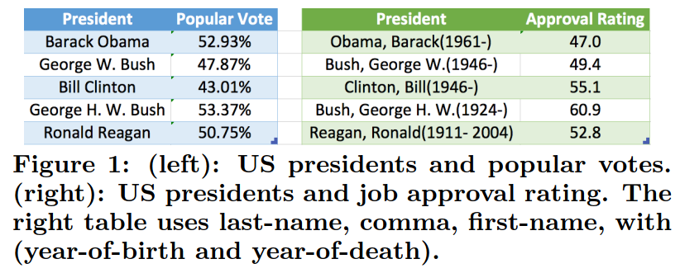
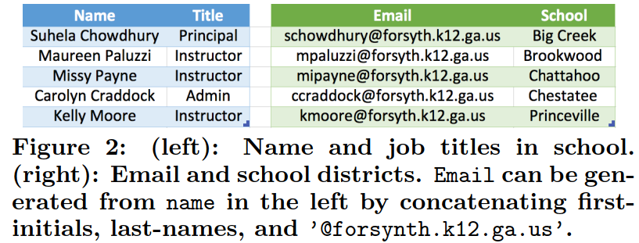
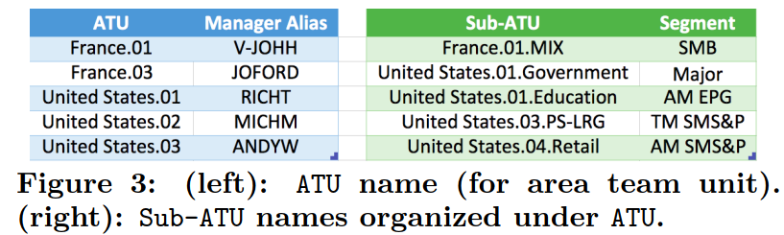
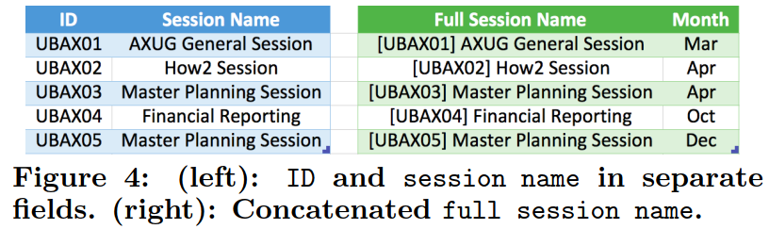
Diversity of Fuzzy Cases
Auto-Join: Joining Tables by Leveraging Transformations, Zhu et al.

Slide 86
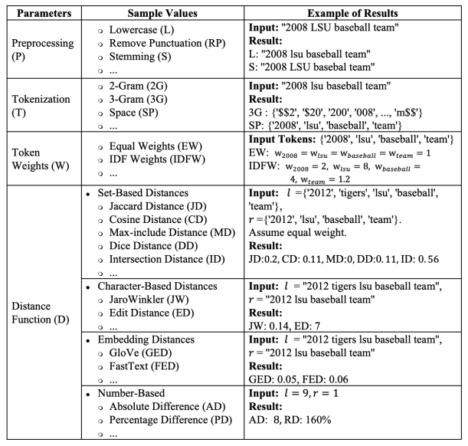
Handling Fuzzy Cases
Text-based similarity
N-gram, Jaccard Distance, Edit Distance, etc.
Embedding-based similarity
Retrieval-based methods
Domain knowledge
Sensor data of nearby locations
An event and the weather data collected in the same day.
Auto-FuzzyJoin: Auto-Program Fuzzy Similarity Joins Without Labeled Examples, Li et al.

Slide 87
Forming Final RDB Schema
Join alignment produces PK/FK pairs and FK/FK pairs
Each FK/FK pair can be converted to two new PK/FK pairs:
Combined set of PK/FK pairs define the final RDB.
Other possibilities exist as well (e.g., based on various DB normal forms, etc.)
FK/FK pair
PK/FK pair
PK/FK pair
C_{i}
b
a
c
a
C_{j}
b
b
a
c
C_{i}
b
a
c
a
C_{j}
b
b
a
c
C_{k}
a
b
c
new auxiliary table

Slide 88
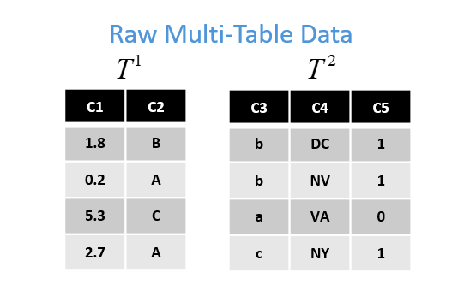
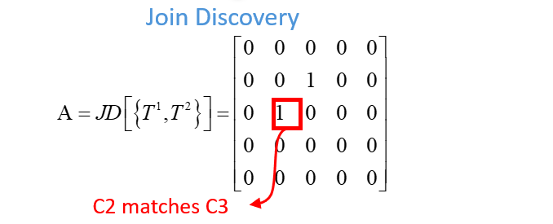
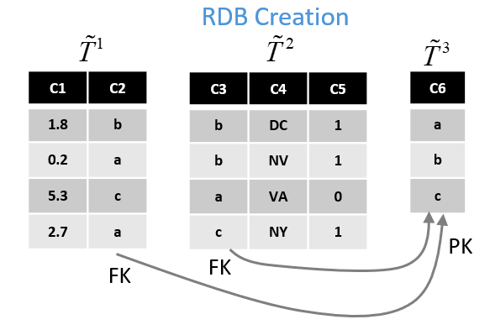
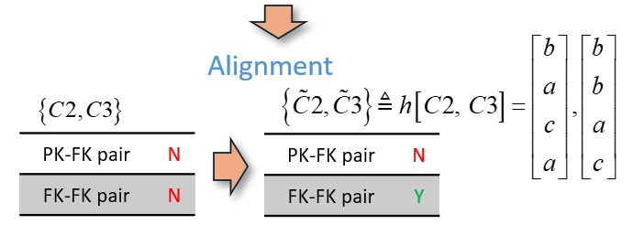
Toy End-to-End Example

Slide 89
01
02
Schema Discovery
Graph Construction
03
04
Predictive Architecture
Resources & Future Directions

Slide 90
Key design choices
What are nodes? What are edges?
Row-wise
Column-wise
Cell-wise
How to retain the original tabular structural/semantical information?
Ideally the mapping from tables -> graph should be bijective.

Slide 91
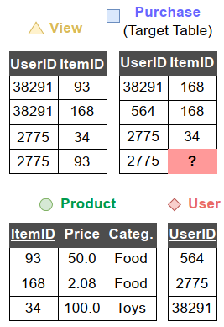
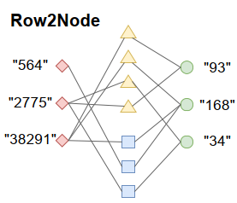
Row2Node
Treat each row as a node.
PK-FK relationships form the edges.
Rows of different tables are mapped to nodes of different types. Similarly, different PK-FK relationships are mapped to different edge types. The result graph is thus a heterogeneous graph.
Other row attributes become the node features. No edge features.
See paper [Cvitkovic, 2020] for details.
Supervised Learning on et al. Relational Databases with Graph Neural Networks, Milan Cvitkovic

Slide 92
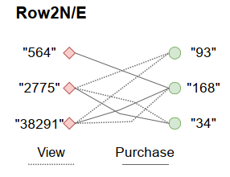
Row2Node/Edge
Extend upon Row2Node to further map some rows to edges.
Basic consideration is to identify tables that represent binary relationships
Tables with only two foreign keys and no primary keys
The result graph can have edge features.
If the prediction is on the rows that are mapped to edges, the task is converted to a link prediction task.

Slide 93
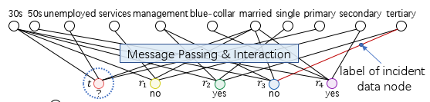
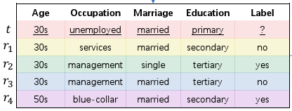
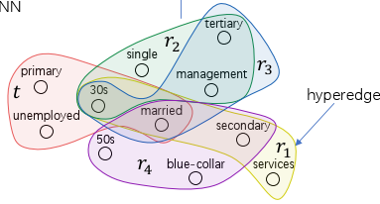
Hypergraph
Rows with more than 2 FKs represent high-order relationships, and can thus be mapped to hyperedges.
Row2Node can be viewed as the star expansion of such hypergraph.
Star Expansion
Hypergraph construction
Learning Enhanced Representations for Tabular Data via Neighborhood Propagation, Du et al., 2022

Slide 94
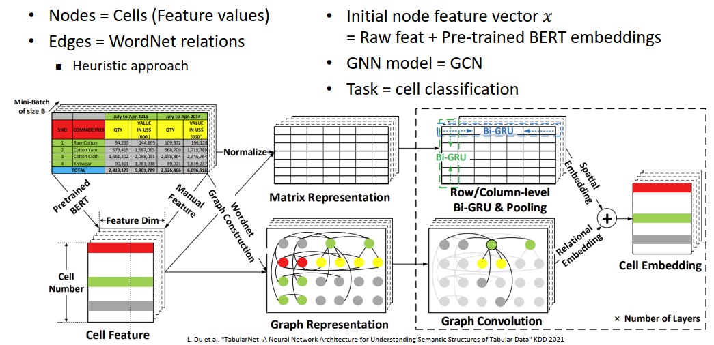
Cell-wise graph
WWW’23 Tutorial: Graph Neural Networks for Tabular Data Learning

Slide 95
01
02
Schema Discovery
Graph Construction
03
04
Predictive Architecture
Resources & Future Directions

Slide 96
Predictive task on RDB
Target Column
Target Table
MobileInfo
UserID | OS | AppVer | IP | Date
1 | iOS 15 | 2.0.2 | xx.xx.xx.xx | 2002/05/06
1 | iOS 15 | 2.0.2 | xx.xx.xx.xx | 2002/05/06
1 | iOS 15 | 2.0.2 | xx.xx.xx.xx | 2002/05/06
1 | iOS 15 | 2.0.2 | xx.xx.xx.xx | 2002/05/08
2 | Android 13 | 2.0.0 | xx.xx.xx.xx | 2002/05/09
FraudulentUsers
UserID | Date | Country | IsFraud
1 | 2002/05/06 | US | True
2 | 2002/05/06 | US | False
1 | 2002/05/08 | US | False
2 | 2002/05/08 | US | ?
3 | 2002/05/08 | Japan | ?
Values to predict
CreditCard
CardID | CardNumber | ExpiryDate | Status
1001 | xxxxxxxxx | 2006/04/08 | 0
1002 | xxxxxxxxx | 2005/03/27 | 0
1003 | xxxxxxxxx | 2006/09/12 | 0
1004 | xxxxxxxxx | 2007/12/11 | 1
Topup
MerchantID | UserID | CardID | Amount | Date
A | 1 | 1001 | 20.00 | 2002/05/06
B | 1 | 1003 | 8.00 | 2002/05/08
A | 2 | 1002 | 23.00 | 2002/05/08
B | 3 | 1001 | 8.50 | 2002/05/08

Slide 97
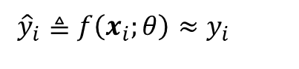
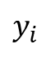
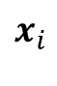
Single-table prediction
diverse features
target
FraudulentUsers
UserID | Date | Country | IsFraud
1 | 2002/05/06 | US | True
2 | 2002/05/06 | US | False
1 | 2002/05/08 | US | False
2 | 2002/05/08 | US | ?
3 | 2002/05/08 | Japan | ?
$$x_{i}$$
$$y_{i}$$
IID assumption across table rows:
$$\log{p}\left(X,y\right)=\sum_{i}{\log{p}\left(x_{i},y_{i}\right)}=\sum_{i}{\log{p}\left(y_{i}|x_{i}\right)}+C$$
Goal: Learn a row-wise predictive model (e.g. with AutoGluon [1], XGBoost [2], etc.)
$${\hat{y}}_{i}≜f\left(x_{i};θ\right)≈y_{i}$$
[1] AutoGluon-Tabular: Robust and Accurate AutoML for Structured Data, Erickson et al.
[2] XGBoost: A Scalable Tree Boosting System, Chen at al.

Slide 98
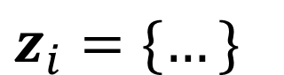
Going to multiple tables
MobileInfo
UserID | OS | AppVer | IP | Date
1 | iOS 15 | 2.0.2 | xx.xx.xx.xx | 2002/05/06
1 | iOS 15 | 2.0.2 | xx.xx.xx.xx | 2002/05/06
1 | iOS 15 | 2.0.2 | xx.xx.xx.xx | 2002/05/06
1 | iOS 15 | 2.0.2 | xx.xx.xx.xx | 2002/05/08
2 | Android 13 | 2.0.0 | xx.xx.xx.xx | 2002/05/09
FraudulentUsers
UserID | Date | Country | IsFraud
1 | 2002/05/06 | US | True
2 | 2002/05/06 | US | False
1 | 2002/05/08 | US | False
2 | 2002/05/08 | US | ?
3 | 2002/05/08 | Japan | ?
$$x_{i}$$
$$y_{i}$$
$$z_{i}=\{…\}$$
CreditCard
CardID | CardNumber | ExpiryDate | Status
1001 | xxxxxxxxx | 2006/04/08 | 0
1002 | xxxxxxxxx | 2005/03/27 | 0
1003 | xxxxxxxxx | 2006/09/12 | 0
1004 | xxxxxxxxx | 2007/12/11 | 1
Topup
MerchantID | UserID | CardID | Amount | Date
A | 1 | 1001 | 20.00 | 2002/05/06
B | 1 | 1003 | 8.00 | 2002/05/08
A | 2 | 1002 | 23.00 | 2002/05/08
B | 3 | 1001 | 8.50 | 2002/05/08

Slide 99
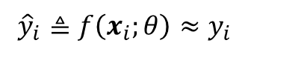


Prediction with context information
$${\hat{y}}_{i}≜f\left(x_{i};θ\right)≈y_{i}$$
$${\hat{y}}_{i}≜f\left(x_{i},z_{i};θ\right)≈y_{i}$$
$${E_{p\left(y|x_{i},z_{i}\right)}\left(y−{\hat{y}}_{i}\right)}^{2}={\left({mean}_{p\left(y|x_{i},z_{i}\right)}\left[y\right]−{\hat{y}}_{i}\right)}^{2}+{var}_{p\left(y|x_{i},z_{i}\right)}\left[y\right], i∈I_{test}$$
Expected prediction error on test sample
Predictor-dependent bias
Predictor-independent variance with context info

Slide 100
How it connects to GML?
It is the same paradigm as GML which collects information from neighbors to assist prediction.
GML
Classifier

Slide 101
Graph-based predictive architectures for RDB
Graph Neural Networks (GNNs)
Scaling GNNs to large graphs
Propagate-then-predict architecture and feature engineering
Label propagation and target encoding
Other unique challenges on graphs extracted from RDB

Slide 102



Graph Neural Networks [Scarselli et al., 2009]
The basic formulation of getting information from neighborhood.
A certain realization

Slide 103



Spectral Networks
Drawing inspiration from Graph Signal Processing and Graph Fourier Transform, researchers tried to design proper localized filters for graph data. Influential papers include [Bruna et al., 2014; Defferrard et al., 2016].
[Kipf et al., 2017] later simplified the formulation into what is well known as Graph Convolutional Networks (GCN).
By Chebyshev polynomial
Linearization (K=1)
Graph Convolutional Networks (GCN)

Slide 104



Message Passing Neural Networks [Gilmer et al., 2017]
Message function:
Update function:
(optional) Readout function:

Slide 105





MP-NN Variants
GCN [Kipf et al., 2017]
GraphSAGE [Hamilton et al., 2017]
Graph Attention Network [Velickovic et al., 2018]

Slide 106



Heterogeneous Graph
Graph that has different types of nodes and edges, often characterized by its schema.
Most real world graphs are heterogeneous.
Knowledge graph
Citation network
E-commerce network
[Sun et al., 2014]

Slide 107



Relational Graph Convolution Network [Schlichtkrull et al., 2017]
Parameterize message function according to edge types (relations) and employ an hierarchical aggregation.
Adopt various regularization tricks to combat over-parameterization when there are many relations. E.g., for KG, it could be >1K!

Slide 108


Heterogeneous Graph Transformer [Hu et al., 2020]
Parametrization according to both node and edge types.
Adopt a flat attention-based aggregation across neighbors (potentially) of different types.
Use dot-product based attention as contrast to the addictive attention in GAT.

Slide 109

Real world graphs are large
MAG240M：Graph 30GB，Feature 200GB。
CPU+GPU mixed training：g4dn.metal, 384GB CPU RAM, $7.824/hr
Pure-GPU training：4x g4dn.metal, 32x T4 GPU, $31.296/hr
Web graph: 4.66B web pages (>10x !!)

Slide 110
Why it’s hard to learn on large graphs?
There is essentially only one (giant) sample!
Almost all instances (nodes) are connected (relevant), so the worst case needs to consider all the instances together.
The connectivity pattern is often long-tailed, meaning each node often has some arbitrary neighbors connected (poor access pattern!)

Slide 111


GNN under the computational lens

Slide 112

GNN under the computational lens

Slide 113

Full graph training

Slide 114


Full graph training
Huge memory footprint.
I/O intensive due to data inter-dependencies.

Slide 115


Minibatch training
Batch #1

Slide 116


Minibatch training
Batch #2
Huge receptive field due to neighborhood explosion

Slide 117


Minibatch training + Sampling
Batch #1
Node-wise neighbor sampling
[Hamilton et al., 2017]

Slide 118


Minibatch training + Sampling
Batch #2
Node-wise neighbor sampling
Still have neighborhood explosion
Sampling may introduce unintended structural bias

Slide 119


Minibatch training + Sampling
Batch #1
Layer-wise sampling
[Zou et al., 2019]

Slide 120


Minibatch training + Sampling
Batch #1
Batch #2
Subgraph-wise sampling
[Chiang et al., 2019; Zeng et al., 2021]

Slide 121



Theoretical property of MP-NNs
[Li et al., 2018] studied the graph convolutional operator used by GCN and found that it leads to trivial distribution.
[Chen et al., 2020] devised quantifiable metrics to measure the degree of oversmoothness and found that it is a universal issue of many GNN architectures.

Slide 122



Theoretical property of MP-NNs
[Xu et al., 2019] studied the expressiveness power of MP-NNs and concluded that it is at most as powerful as 1-WL test.
The key to reach this maximal expressiveness power is to use injective mapping in both node encoders and message aggregators (which is sum in practice).

Slide 123

Making simpler GNNs
As the expressiveness power of MP-NNs is capped by 1-WL test which is a non-learnable process, this shows a possibility to simplify MP-NN architecture.
[Wu et al., 2019] proposed SGC (Simplified Graph Convolutional Networks) which replaces message passing with a non-learnable feature propagation, i.e., a propagate-then-predict architecture.

Slide 124



More details about SGC
GCN Layer:
Linearization:
Simplification:
Propagating feature matrix X

Slide 125

SIGN [Frasca et al., 2020]
The idea was extended by [Frasca et al., 2020] to include R parallel graph diffusion operators. The choice of operators is flexible: normalized adjacency, personalized page-rank adjacency, triangle-based adjacency, etc.
The method is quite scalable as the preprocessing step can be implemented using data processing engines like MapReduce, Spark.

Slide 126







Graph-based predictive architectures for RDB
SGC, SIGN and NARS all belong to the propagate-then-predict architecture.
The technique shares similar spirit with feature engineering methods designed to capture cross-row dependencies [1][2].
Feature Engineering (Propagate)
Modeling (Predict)
[1] Deep Feature Synthesis: Towards Automating Data Science Endeavors, Kanter et al.
[2] ARDA: Automatic Relational Data Augmentation for Machine Learning, Chepurko et al.

Slide 127
Deep Feature Synthesis
Divide relationships into forward (FK->PK) and backward (PK<-FK) relationships.
Recursively collect and aggregate information from other tables to the target table.
Produce features derived from all possible join paths up to the given depth (which can be many!)

Slide 128

Deep Feature Synthesis Example
Customer
(Target Table)
Orders
Products
OrderProducts

Slide 129
Deep Feature Synthesis Example
Customer
(Target Table)
Orders
Products
OrderProducts

Slide 130
Deep Feature Synthesis Example
Customer
(Target Table)
Orders
Products
OrderProducts

Slide 131
Deep Feature Synthesis Example
Customer
(Target Table)
Orders
Products
OrderProducts
Repeat this process for all combinations of aggregators.
Feed the augmented table to downstream single-tabular model

Slide 132
GNN v.s. Propagate-then-predict
GNN is learned end-to-end while Prop-then-Pred has a cascade pipeline.
GNN is often more computationally costly especially since features can be prepared offline using large-scale batching system like Spark and SQL engines.
Empirical evidences [1][2] show that GNN (with the right graph) can out-perform Prop-then-Pred.
[1] Supervised Learning on Relational Databases with Graph Neural Networks, Cvitkovic et al.
[2] 4DBInfer: A 4D Benchmarking Toolbox for Graph-Centric Predictive Modeling on RDBs, Wang et al.

Slide 133

Empirical Comparison
Supervised Learning on Relational Databases with Graph Neural Networks, Cvitkovic et al.

Slide 134


Empirical Comparison
4DBInfer: A 4D Benchmarking Toolbox for Graph-Centric Predictive Modeling on RDBs, Wang et al.

Slide 135

Empirical Comparison
GNNs is much more costly than feature engineering + tabular models
4DBInfer: A 4D Benchmarking Toolbox for Graph-Centric Predictive Modeling on RDBs, Wang et al.

Slide 136


Propagating labels
Nodes sharing the same labels tend to connect with each other (homophily property).
Label propagation algorithm:
P is the probability of node v having label c.
Repeat until convergence.

Slide 137

Advanced label propagation
[Huang et al., 2020] proposed correct & smooth framework to smooth error residual across network.
[Wang et al., 2022] proposed label trick that combines label propagation with feature propagation. Random masking and soft labeling are adopted to avoid label leakage.
Label + feature propagation performs quite well on OGB leaderboards especially on large graphs.

Slide 138
Target Encoding
Encode high-cardinality categorical features with statistics (e.g., mean) of target values calculated from the observed training sets.
A special case covered by the Deep Feature Synthesis framework
FraudulentUsers
UserID | Date | Country | IsFraud
1 | 2002/05/06 | US | True
2 | 2002/05/06 | US | False
1 | 2002/05/08 | US | False
2 | 2002/05/08 | US | ?
3 | 2002/05/08 | Japan | ?
FraudulentUsers
UserID | Date | Country | IsFraud | IsFraudRate(UserID)
1 | 2002/05/06 | US | True | 0.5
2 | 2002/05/06 | US | False | 0.9
1 | 2002/05/08 | US | False | 0.5
2 | 2002/05/08 | US | ? | 0.9
3 | 2002/05/08 | Japan | ? | 0.1

Slide 139
Unique challenges on graphs extracted from RDB
Node/edge features have tabular structure, different from normal graph datasets where one vector feature is typically assumed.
[1] combines tabular NN models (e.g., DeepFM) with GNNs to retain such structural information.
Data leakage, e.g., column-wise, temporal
Temporal neighbor sampling [2][3]
Data masking
Prediction Target
UserReviews
UserID | ItemID | Review | Rating
1 | A | Great product | 5
2 | B | Not great but good enough | 4
3 | C | Mediocre | 3
4 | D | I don’t like this | 2
[1] GFS: Graph-based Feature Synthesis for Prediction over Relational Databases, Zhang et al.
[2] Inductive Representation Learning on Temporal Graphs, Xu et al.
[3] Temporal Graph Networks for Deep Learning on Dynamic Graphs, Rossi et al.
Leakage column

Slide 140
01
02
Schema Discovery
Graph Construction
03
04
Predictive Architecture
Resources & Future Directions

Slide 141

Datasets & Benchmarks

Slide 142


Datasets & Benchmarks
Carefully curated from multiple data sources
Realistic task setup
Temporal / non-temporal
Inductive / transductive
Entity / relationship prediction
Diverse baselines for study
GNNs
Feature engineering + Tabular ML

Slide 143

Datasets & Benchmarks
GitHub repo: https://github.com/awslabs/multi-table-benchmark/
One click to access 8 RDB datasets and 14 prediction tasks
Running any baseline with one command
pip install dbinfer-bench
>>> import dbinfer_bench as dbb
>>> dbb.load_rdb_data(“diginetica”)

Slide 144
Datasets & Benchmarks
RDBench: Evaluated GNNs v.s. simple join-based solutions. 3 tiers of RDB datasets processed from the CTU Prague RelationalRepo.
RelBench: Evolving RDB benchmarks from an initial set of 2 datasets (more planned).
CTU Prague RelationalRepo (relational-data.org): 80+ RDB datasets for testing predictive ML. Data size and complexity is a bit under modern standard.
Kaggle: Mostly focus on single-table datasets. Multi-table datasets often do not have rigorous schema.
UCI Machine Learning Repository: 600+ datasets. Mostly single-table.

Slide 145


Future Directions: LLM as data scientist
LLM’s common world knowledge may help identify important features.
E.g., product sales depend on product type, seasonality, product price, etc.
CAAFE [Hollmann et al., 2023] evaluated LLM-generated features v.s. AutoFE methods like Deep Feature Synthesis. LLM-Select [Jeong et al., 2024] devised metrics to measure feature qualities. ELF-GYM [Zhang et al., 2024] compared LLM-generated features with those crafted by Kaggle experts.

Slide 146



Future Directions: Foundational Models for Relational Data
Graph Transformers [Dwivedi et al., 2020]
Graph Foundational Models [Liu et al., 2024; Chen et al., 2024]
Table LLMs [Hegselmann et al., 2023; Zhang et al., 2024]

Slide 147
Thank You for Attending!
All materials will be available on https://github.com/dglai/GML-on-Multi-Tables
Follow our X account DGLGraph@ for more update and release.
Check out our survey paper

